Slide 1
What’s going on in English, you ask?
October 25, 2019
Language Arts Retreat
Notes:
Both

Slide 2
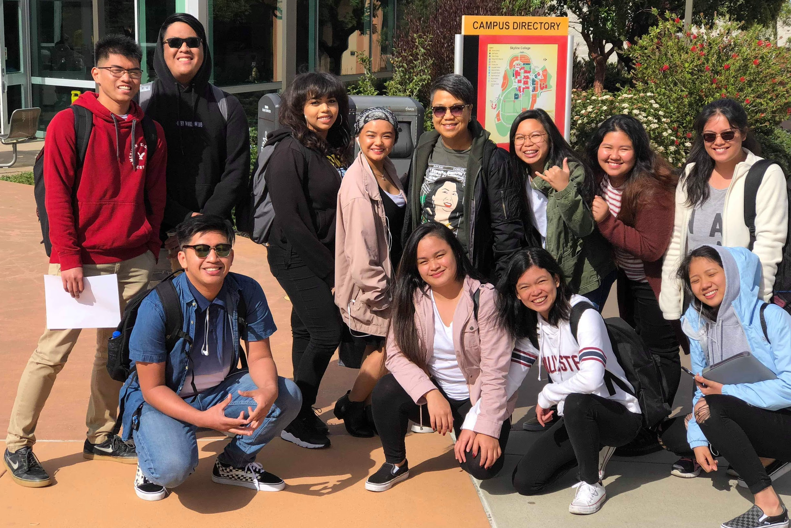
English Department Philosophy
The English Department philosophy integrates curriculum with multiple cultural and political perspectives enabling our students to gain social awareness through considering views from different cultural, ethnic, gender, sexual orientation, socio-economic, political, and religious backgrounds.
Notes:
Nathan (read ad-lib)

Slide 3
English Department General Overview
Our Student-Centered English Program Offers A Diverse Range of Courses, Including:
Developmental and Transfer-Level Composition
Literature
Creative Writing
Notes:
Rob (Read)

Slide 4
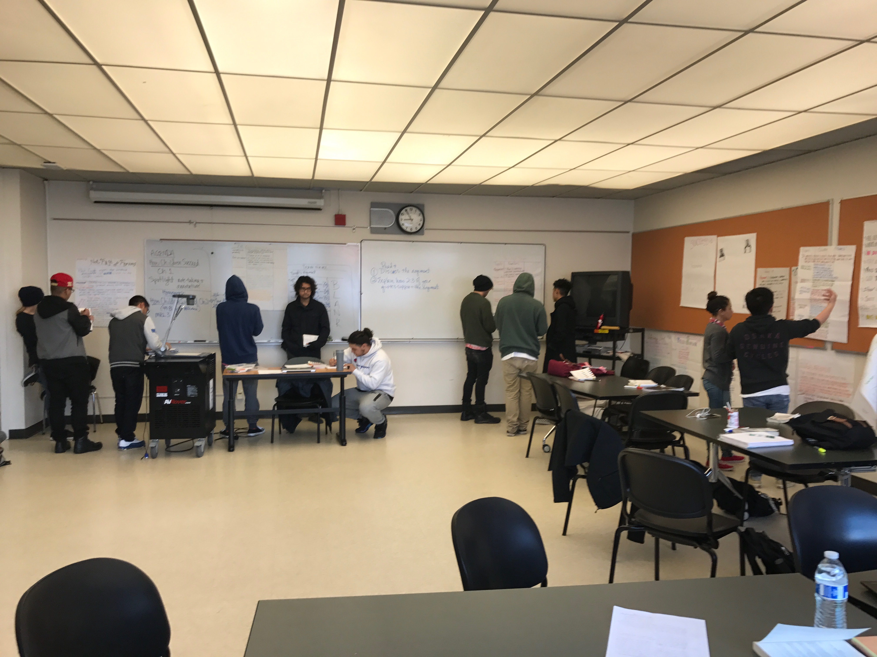
Where we are now (in response to AB-705)…
We created Transfer-Level, Equivalent to ENGL 100, with more support = English 105
This Eliminated Two Exit Points: 828 and 846
Affective Domain: Student-Focused
All Full-time and nearly all Part-time faculty participated in the Community of Practice Pedagogy Sessions
We have reconnected with our sister campuses—3-department Flex meeting
Building stronger bridges with the Learning Center, DRC, Library and other campus resources
Notes:
Rob
One class we are especially proud of is English 105: Composition with Support. Nearly all of our full and part time faculty have taken part in a training program for this course, which we call a Community of Practice. These COP trainings have been held since 2014 and are facilitated by our interim Dean, Chris Gibson, and Faculty Member Jarrod Feiner.
English 105 has put emphasis on Affective Domain--and we have been implementing this into our pedagogy long before learning about AB705.

Slide 5
English Course Progression Comparisons
 | Enrolled Fall 2016 n | Passed Fall 2016 n | Passed Fall 2016 % | Progressed to ENGL 110 by Spring 2018 n | Passed ENGL 110 by Spring 2018 n | Passed ENGL 110 by Spring 2018 %
ENGL 100 | 742 | 487 | 66% | 412 | 355 | 48%
ENGL 105 | 438 | 318 | 73% | 266 | 216 | 49%
ENGL 846 | 292 | 171 | 59% | 47 | 38 | 13%
Notes:
All Fall 2016 enrollment based on Skyline College courses; Progression columns based on District-wide course-taking.
The way to interpret this slide is the share of students who enrolled in and passed ENGL 100 in Fall 2016 and went on to ever pass ENGL 110 by Spring 2018 is 48%
Etc…..etc….

Slide 6
Success and Retention
 | Success | Retention
Statewide For English | 60.4% | 81.7%
General Skyline | 72.3% | 86.0%
Core English Classes | 68.7% | 83.1%
Literature | 80.7% | 87.3%
Literature (Online) | 84.5% | 87.3%
Notes:
Nathan
Core Classes: Success: 68.7% ; Retention 83.1% (3 point climb since last PR)
Literature classes: Success: 80.7% ; Retention: 87.3% (Increase due to Online Courses)
Read only the General Skyline, Core English Classes and Lit Online
Chris: It would be good to include disaggregated data if possible.--maybe a new slide with this? Rob emailing Zahra

Slide 7
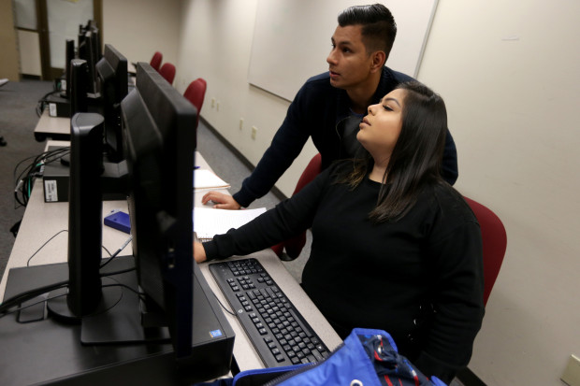
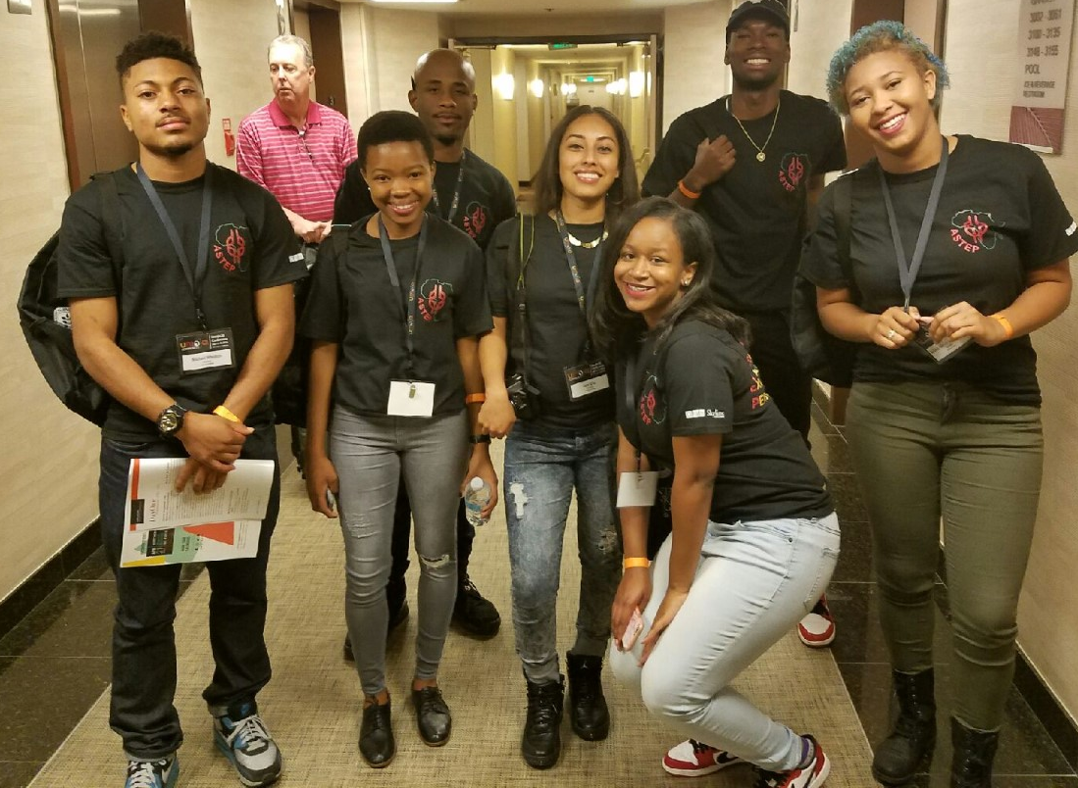
Equity Projects
Learning Communities
ASTEP
CIPHER
Kababayan
Puente
FYE
Culturally Relevant Literature Courses
Asian American Literature
Black Literature
Filipino American Literature
Literature of the Latino in the U.S.
Queer Literature
Social Justice Focus
Equity Training Series
Inclusive Curriculum
Notes:
Nathan
As an English Department we take pride in offering culturally relevant literature courses
Social Justice: As previously mentioned, we are planning to align our Ethnic Literature courses with the Social Justice Studies Program
Many of our courses are designed with a Social Justice focus which connects to Skyline’s “Mission and Vision”
Inclusive Curriculum: We design dynamic curriculum that speaks to our students’ individual experiences and their lives
ensuring that our syllabi, books, and assignments reflect our student population and their learning needs.

Slide 8
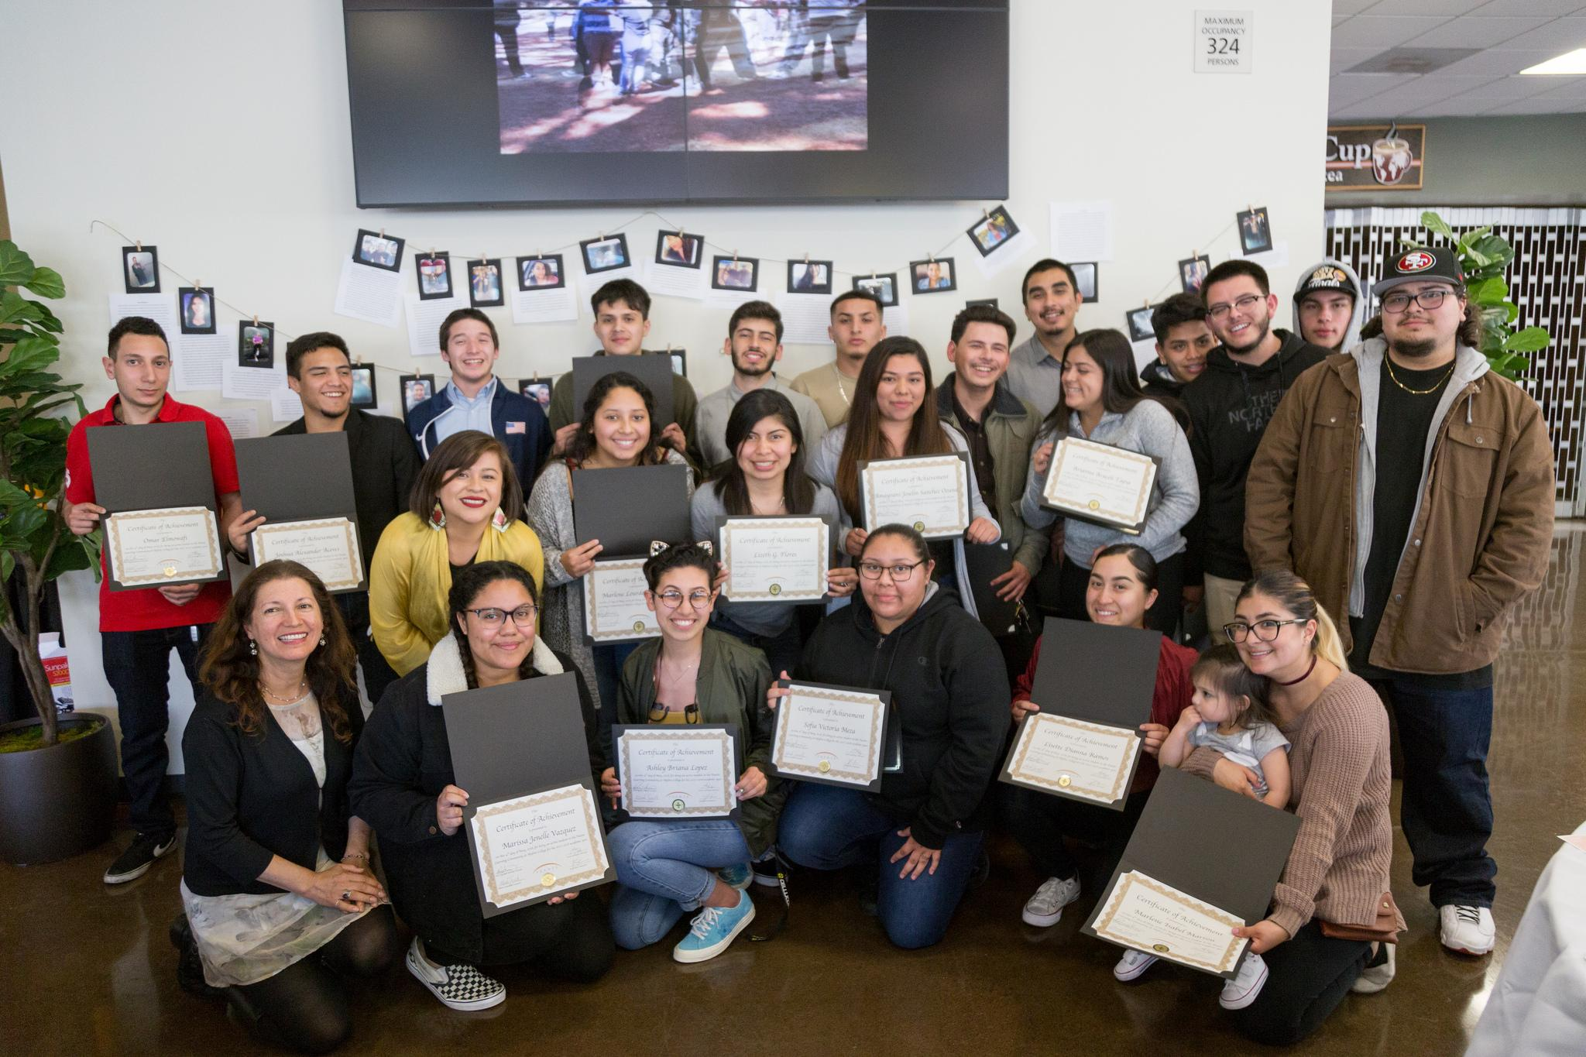
Accomplishments
Collaboration with The Learning Center for Student Support
Active Participation in Middle College
Faculty Leadership in Jump Start
Leadership in Learning Communities
Increased Distance Education Offerings
Online Faculty Training for Core And Literature Classes
ENGL 105 Community of Practice
Notes:
Nathan
Our department has enjoyed continued collaboration with the Learning Center
We have expanded our Distance Education offerings to make sure courses are available to all students, which helps us support Skyline’s focus on completely online degrees as well as Skyline Now.
English 105 classes have contributed to the success of English students by removing multiple barriers to historically underserved and disproportionately impacted students, thus providing them with access to Transfer Level English courses.
5 Cohort CoP in our English Department

Slide 9
Where we are going:
We will focus on:
Increasing Student and Faculty Support under AB-705
Continuing Involvement in Comprehensive College Redesign
Improving Success and Retention Rates Especially for Disproportionately Impacted Students
Strengthening the Literature Course Offerings
Continuing Refining Assessment Methods
Fostering Greater Inclusion and Support for Part Time Faculty
Hiring More Full-Time Faculty
Notes:
Rob
We will be increasing Student and Faculty Support under AB 705. I’m part of the CSI Taskforce subgroup working on developing Professional Development workshops, activities, and exercises to prepare faculty AND staff for AB705
We take seriously the goal to improve success and retention rates especially for disproportionately impacted students; one way we do this is in our department meetings, which we have restructured into English faculty workshops to strengthen our equity based pedagogy.
We will continue to foster greater inclusion and support for our wonderful Part Time Faculty-- especially because they make up 70% of Skyline College Workforce, and, well, we like them.
And finally, we look forward to opportunities to hire more Full-Time Faculty so that we can continue to create exciting new pedagogy to ensure our classes are student ready.

Slide 10
Challenges:
Increasing Student and Faculty Support under AB-705
Challenge: budget to upscale embedded tutors, librarians, counselors, tutors
Continuing Involvement in Comprehensive College Redesign Challenge: Having time to commit to major initiatives
Improving Success and Retention Rates Especially for Disproportionately Impacted Students Challenge: Especially with post AB-705 with more under-prepared students in transfer level classes
Strengthening the Literature Course Offerings Challenge: the Lit courses are not consistently filling and are getting cancelled
Continuing Refining Assessment Methods Challenge: Need to pilot the new assessment model and make sure we are reaching 100% compliance for all classes in a 3-year cycle
Fostering Greater Inclusion and Support for Part Time Faculty Challenge: Budget cuts for meeting attendance
Hiring More Full-Time Faculty Challenge: Budget! ☺
Notes:
Rob
We will be increasing Student and Faculty Support under AB 705. I’m part of the CSI Taskforce subgroup working on developing Professional Development workshops, activities, and exercises to prepare faculty AND staff for AB705
We take seriously the goal to improve success and retention rates especially for disproportionately impacted students; one way we do this is in our department meetings, which we have restructured into English faculty workshops to strengthen our equity based pedagogy.
We will continue to foster greater inclusion and support for our wonderful Part Time Faculty-- especially because they make up 70% of Skyline College Workforce, and, well, we like them.
And finally, we look forward to opportunities to hire more Full-Time Faculty so that we can continue to create exciting new pedagogy to ensure our classes are student ready.

