Slide 1
AB 705 Deep dive
Chelssee De Barra, Chris Gibson, David Hasson, Melissa Matthews

Slide 2
The Problem: Historical inequities in English and Math placement disproportionally impacts students of color and their college completion
The State’s Fix: AB 705, unfunded mandate, eliminates placements based on high-stakes testing and limits pre-transfer course sequences
The Goal: Increase English and Math throughput
The Charge: Colleges must innovate to integrate services and supports as students take college level English and Math classes

Slide 3
The response

Slide 4
Accelerated
Developmental
Education
Educational Access Center
AB 705 Response
The Learning Commons
Directed Learning Activities
(DLAS)
Faculty Training/ Transformative Teaching
= Persistence
Notes:
CDB

Slide 5
Increased sections of
Learning Communities
Accelerated Developmental Education ENGLISH
Supplemental Instruction
Embedded Tutoring
Integrated technology
Embedded Counseling
Word Jam to provide refresher for students during intersessions
Notes:
CG

Slide 6
Resources Needed
0.2
FTE
Chromebooks
FTE for the creation of Word Jam/ development of DLAs
Training for faculty in Transformative Teaching & Learning
Faculty, IA-II, instructional design, and technical support for creation of DLAs
Notes:
CG

Slide 7
Embedded counseling
Accelerated Developmental
Education
MATH
Co-Requisite courses to build foundational skills while completing core course
BSTEM & SLAM pathways to contextualize math to overall meta-major
Supplemental Instruction
Embedded tutoring
Math Jam to provide refresher for students during intersessions
Notes:
DH

Slide 8
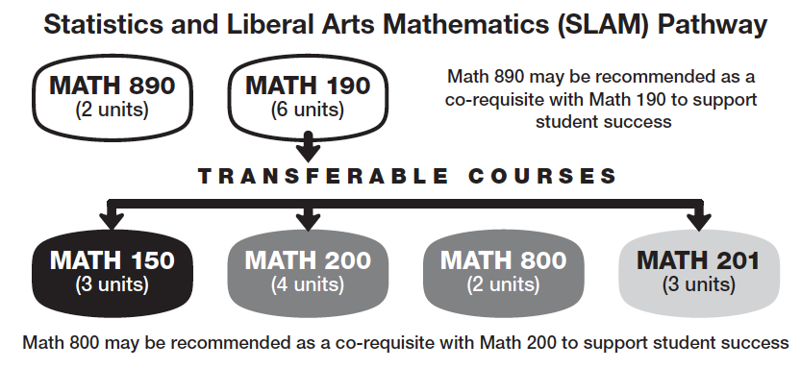
SLAM Pathway
SLAM Level | HSGPA | Default Rec | Expected success w/out co-req | Co-req
1 | HS Alg 1/ Intergrated Math 2 not taken | Path to Statistics MATH 190 | Low | Math 890 strongly rec’d
2 | HS Alg 1/ Integrated Math 2 w/ a grade ≤ C- |  | Moderate | Math 890 rec’d
3 | Less than 2.3 | Math for Elem School Teachers MATH 150 Statistics MATH 200 Math in Society MATH 201 | 29% | Math 800 strongly rec’d
4 | 2.3 to 2.9 |  | 50% | Math 800 Rec’d
5 | 3.0 or greater |  | 75% | Math 800 optional
Statistics and
Liberal
Arts
Mathematics
&
Exploring students
Notes:
DH

Slide 9
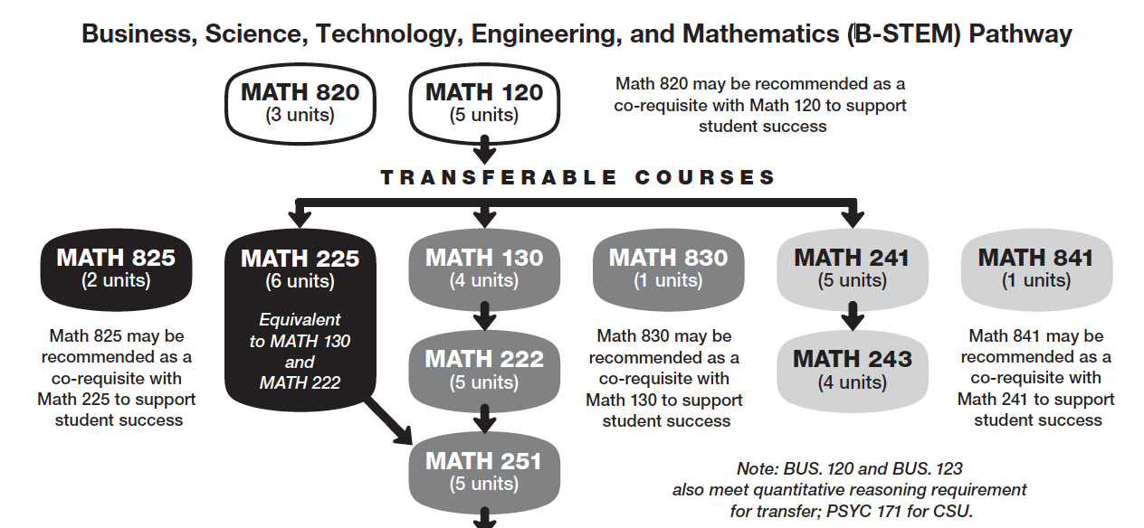
B-STEM Pathway
SLAM Level | HSGPA | Default Rec | Expected success w/out co-req | Co-req
1 | No HS Alg 2/ Intergrated Math 3 | Intermediate Algebra MATH 120 | Low | Math 820 strongly rec’d
2 | HS Alg 2/ Integrated Math 3 w/ a grade ≤ C- |  | Moderate | Math 820 rec’d
3 | Less than 2.6 & no HS Pre-Calc | Trigonometry MATH 130 Path to Calculus MATH 225 Applied Calculus I MATH 241 | 28% | Math 825, 830, 841 strongly rec’d
4 | 2.6 to 3.3 or took HS Pre-Calc |  | 53% | Math 825, 830, 841 rec’d
5 | 3.4 or greater or took HS Calc |  | 75% | Math 825, 830, 841 option
Business
Science
Technology
Engineering
&
Mathematics
Notes:
DH

Slide 10
B-STEM Coordinator
Resources Needed
SLAM Coordinator
0.2
FTE
0.2
FTE
Training for faculty in Transformative Teaching & Learning
Faculty, IA-II, instructional design, and technical support for creation of DLAs
Notes:
DH

Slide 11
Increased online access to services
1:1 math tutoring
Increased support
for technology
Reading support
Embedded tutors
The Learning Commons
Academic support plans
Supplemental Instruction
On-demand classroom tutoring & workshops
Notes:
CDB

Slide 12
Academic Support in the Classroom
2018-2019
2019-2020
25 sections supported by embedded tutors
70 sections supported by SI Leaders
Pilot of in-classroom tutoring and workshops by request
Online tutoring through NetTutor only
Math tutoring via group tutoring only
50 sections supported by embedded tutors
90 sections supported by SI Leaders
In classroom workshop and tutoring by request available across disciplines
6 sections supported by embedded online tutoring + NetTutor online tutoring
1:1 to 1:3 math tutoring
Notes:
CDB

Slide 13
Additional Support
Reading support strategies across disciplines
Increased academic and soft skill coaching through Peer Mentors
Online Peer Mentor pilot
Collaboration/data sharing with Meta-Major counselors and Promise Scholar staff
Customized academic support plans
Additional research and technology support for students in collaboration with the Library and CTTL
Centralized academic support training
Notes:
CDB

Slide 14
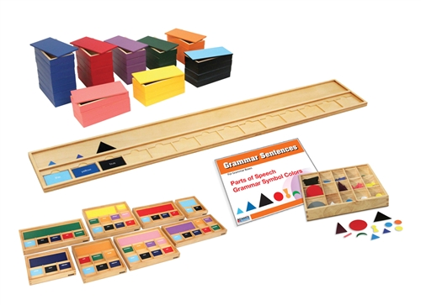
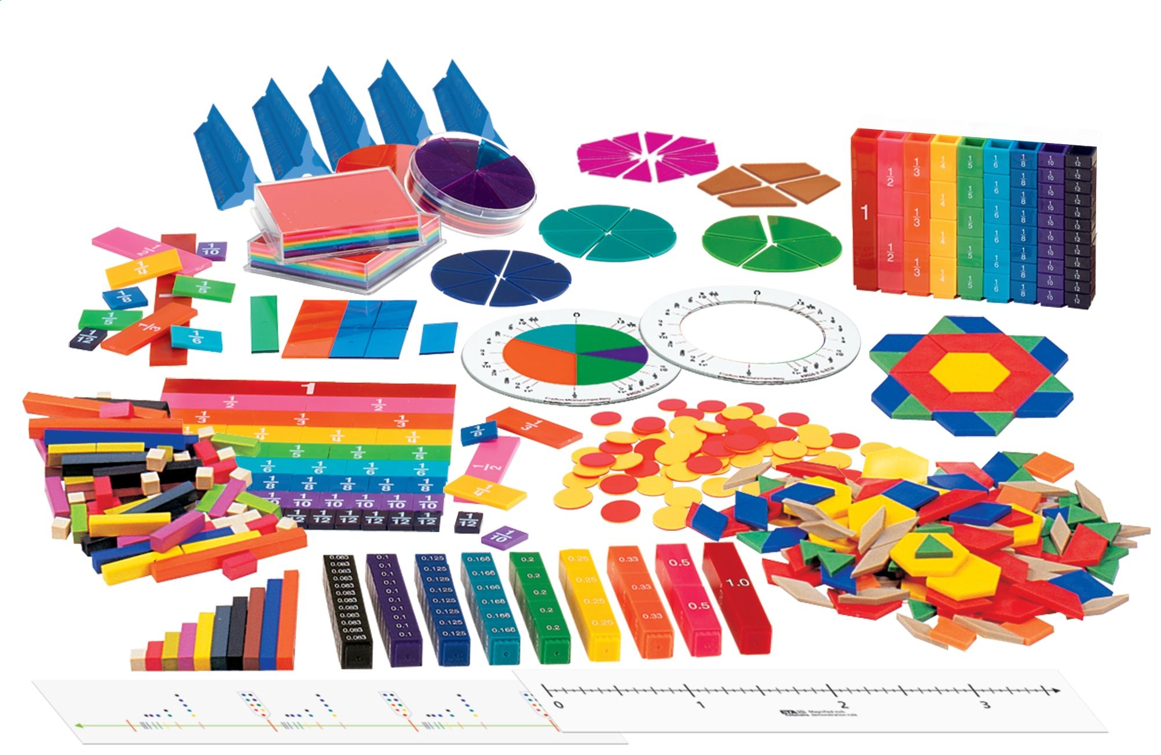
Resources Needed
Budget increase for peer & graduate academic support leaders
Reading Apprenticeship training
English and Math manipulatives
Peer leaders
Graduate Tutors/IA II’s

Slide 15
Disability Resources
Gateway to English
Gateway to Math
Educational Access
Center
EdTech
Notes:
MM

Slide 16
Gateway to Math/English
EDAC 811 – Self paced, individualized modules to provide accelerated acquisition of fundamental math skills. Facilitated by IA-II provides structured environment for completion. Utilize DLAs that span the curriculum.
Non-high school graduates
Returning adult learners (+10 years outside of high school)
Students with disabilities who had significant modification of their high school curriculum
Students who do not have a transfer/degree goal
EDAC 846 – Self-paced, individualized modules to provide accelerated acquisition of fundamental English skills. Utilize DLAs that span the curriculum.
Notes:
Around 28% of students at Skyline are beyond 10 years out from high school; research finds older, returning students have more negative feelings towards math and have less academic preparedness for math; additionally, they find it more challenging to seek support outside of the classroom. Gateway to Math would allow them to close the skill gap before moving into higher stakes coursework.

Slide 17
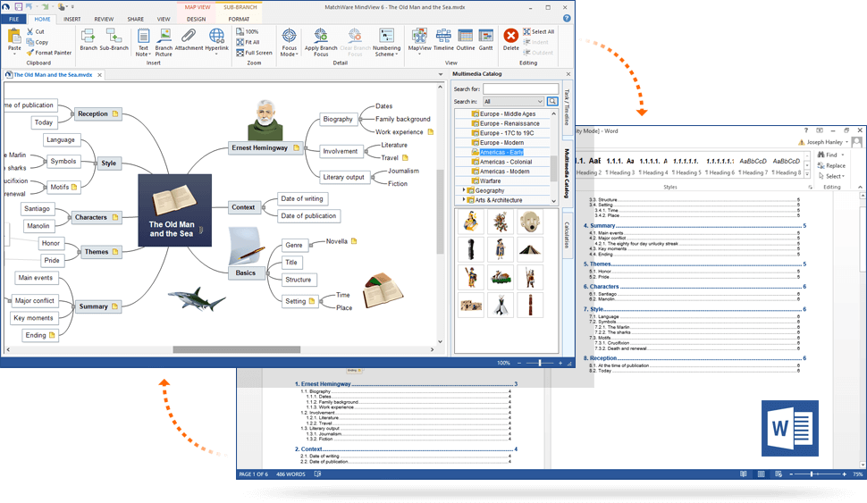
EdTech
Available to all students
Provides students opportunity for Universal Design for Learning by giving them access to technology tools (hardware and software) along with support/strategies to use these tools successfully
Notes:
Research shows benefits of UDL; there’s a gap in research about the use of EdTech for students to create their own UDL, our AT Specialist is interested in conducting research in this area.

Slide 18
Resources Needed
OVL
3 hrs/wk
IA-II Math
40% of FT
EdTech for Loans
IA-II
English
PT
Faculty, IA-II, instructional design, and technical support for creation of DLAs
Notes:
We’re projecting around $65,000/yr. Could potential get EdTech funding through Instructional Equipment or PIF.

Slide 19
Training: Wanted and Needed!
Addressing skill gaps
Infusing soft skills
Source: Faculty focus group conducted by CSI Committee
Notes:
Focus group conducted by CSI Committee found that faculty would like training in how to address the skills gap and how to infuse soft skills into their classrooms.

Slide 20
Increased persistence = Increased graduation rates!
Notes:
MM

Slide 21
Addendum : The Memos
Guidance from California Community Colleges Chancellor’s Office (CCCCO)

Slide 22
AB 705 stresses a maximum of 1 year time frame
One year limit begins once individual students begin taking math & English courses that are part of a sequence leading to transfer level
Prep activities do not count as part of the 1 year time frame for AB 705
Funding formula favors completion of math & English in 1st year of enrollment
- July 11, 2018 Memo from CCCCO
For funding & educational reasons, colleges will want to try to ensure as many students as possible complete in the 1st year; however, AB 705 does not require it.
– Dec. 7, 2018 Memo from CCCCO
Notes:
CG –1 year from the time they start Engl/Math to complete the sequence; prep activities do not start the clock

Slide 23
Colleges are required to use high school transcript information to place students in their initial English and math courses.
- July 11, 2018 Memo from CCCCO
Colleges will need to innovate to determine how best to serve returning students. Similarly, colleges must also serve other populations who may have foundational learning needs, and these students must also be served within the context of AB 705, but their needs may require colleges to consider other curricular supports or reforms.
- July 11, 2018 Memo from CCCO
Notes:
CG – placement recommendations looking at someone who has completed high school w/in 10 years; need to innovate for returning students who were beyond the 10 years

Slide 24
Colleges can use a variety of funding sources to support the work of implementing AB 705.
Student Equity and Achievement Program (SEA) funding, which encompasses what was formerly known as Basic Skills, can support this work, as can Guided Pathways funding in addition to general fund dollars.
Colleges should examine the use of SEA funding to ensure that planning and activities are not solely housed in either student services or academic affairs but instead address the needs of the colleges and students holistically.
Dec. 7, 2018 Memo from CCCCO
Notes:
CG - Unfunded mandate – use SEA funds and be creative

Slide 25
Addendum: English & Math Placement
Guidance from SMCCCD

Slide 26
English
Group | HS GPA | Placement
1 | ≥ 2.6 | ENGL 100
2 | 1.9 – 2.6 | ENGL 105 (including additional academic & concurrent support)
3 | < 1.9 | ENGL 105 (including additional academic & concurrent support)
Oct. 30, 2018 Guidance Memo from SMCCCD
Notes:
CG – we’re currently in alignment w/ the Chancellor’s recommendations

Slide 27
SLAM Pathway
SLAM Level | HSGPA | Default Rec | Expected success w/out co-req
1 | HS Alg 1/ Intergrated Math 2 not taken | Path to Statistics MATH 190 | Low
2 | HS Alg 1/ Integrated Math 2 w/ a grade ≤ C- |  | Moderate
3 | Less than 2.3 | Math for Elem School Teachers MATH 150 Statistics MATH 200 Math in Society MATH 201 | 29%
4 | 2.3 to 2.9 |  | 50%
5 | 3.0 or greater |  | 75%
Statistics and
Liberal
Arts
Mathematics
&
Exploring students
Notes:
DH -

Slide 28
B-STEM Pathway
SLAM Level | HSGPA | Default Rec | Expected success w/out co-req
1 | No HS Alg 2/ Intergrated Math 3 | Intermediate Algebra MATH 120 | Low
2 | HS Alg 2/ Integrated Math 3 w/ a grade ≤ C- |  | Moderate
3 | Less than 2.6 & no HS Pre-Calc | Trigonometry MATH 130 Path to Calculus MATH 225 Applied Calculus I MATH 241 | 28%
4 | 2.6 to 3.3 or took HS Pre-Calc |  | 53%
5 | 3.4 or greater or took HS Calc |  | 75%
Business
Science
Technology
Engineering
&
Mathematics
Notes:
DH

Slide 29
Addendum: Example sequences

Slide 30
EDAC
811
MATH
120 + 820
MATH
130 + 830
241 + 841
225 + 825
Per memo: Student has 2 semesters (1 year) to complete the math sequence, prep activities do not count for the 1 year timeframe. This sequence is in compliance with AB 705.
EDAC
811
MATH
190 + 890
MATH
200 + 800
150
201

Slide 31
Addendum: Impact on some students with disabilities

Slide 32
English
Group | HS GPA | Placement
1 | ≥ 2.6 | ENGL 100
2 | 1.9 – 2.6 | ENGL 105 (including additional academic & concurrent support)
3 | < 1.9 | ENGL 105 (including additional academic & concurrent support)
Oct. 30, 2018 Guidance Memo from SMCCCD

Slide 33
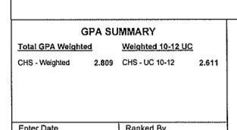

Slide 34
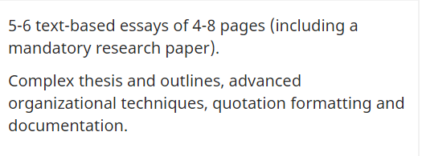
English
Group | HS GPA | Placement
1 | ≥ 2.6 | ENGL 100
2 | 1.9 – 2.6 | ENGL 105 (including additional academic & concurrent support)
3 | < 1.9 | ENGL 105 (including additional academic & concurrent support)
Oct. 30, 2018 Guidance Memo from SMCCCD

Slide 35
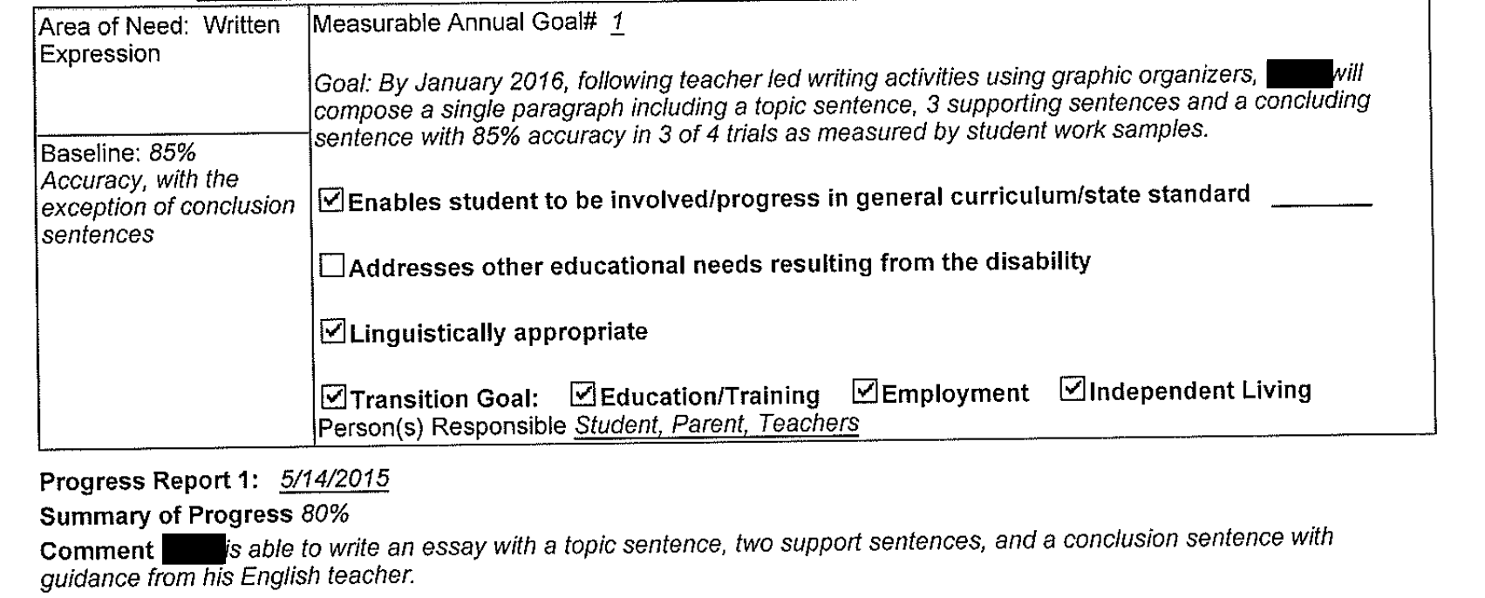
Spring, Senior Year IEP

Slide 36
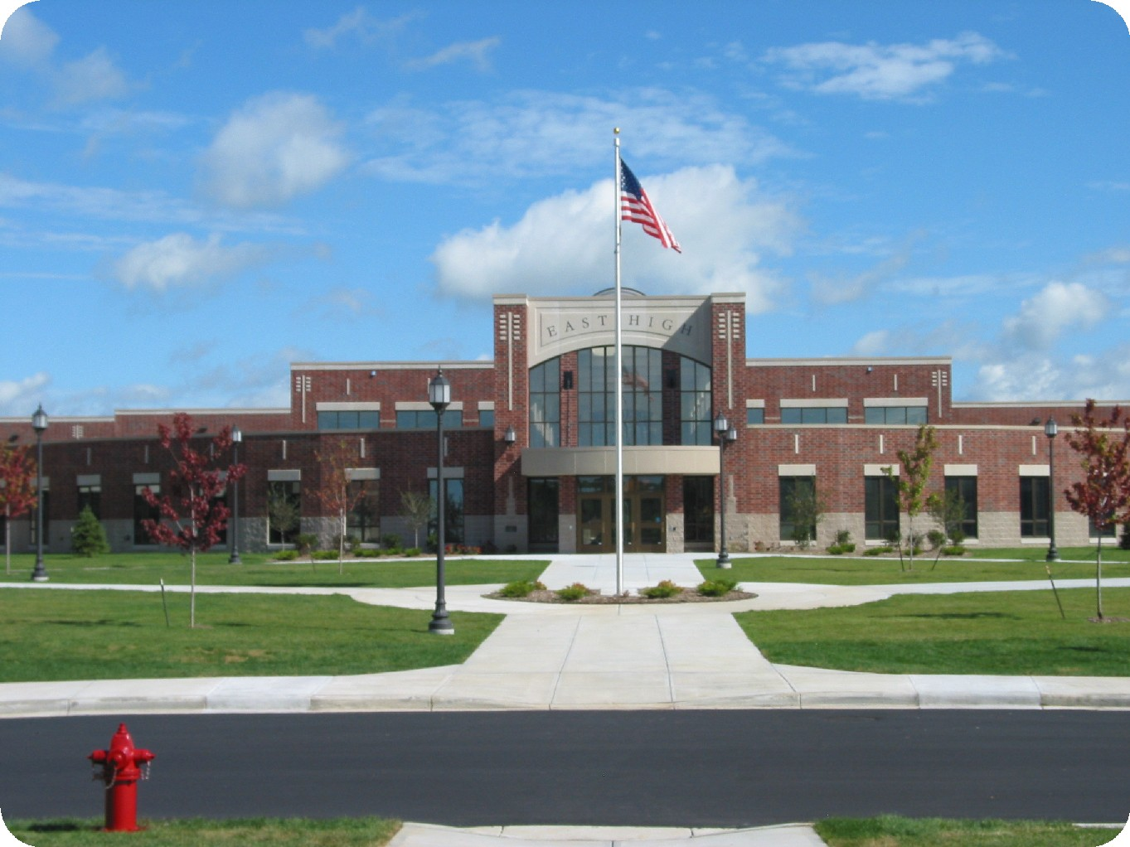
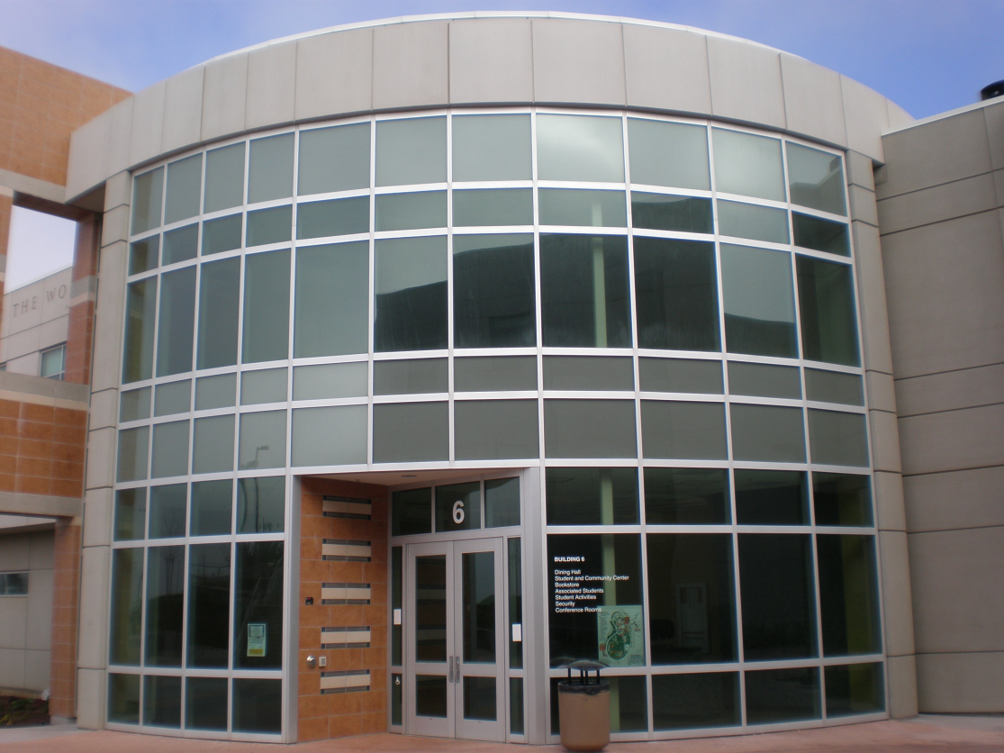
High schools
Follow IDEA, focus is on SUCCESS
Colleges
Follow Section 504 & ADA, focus is on ACCESS

Slide 37
Accommodations are not enough to fill the gap.
No modification of curriculum at the college
Some students need to build a foundation in classes appropriate to their skill level before moving into transfer level courses
We can offer foundation building courses and stay in compliance with AB 705

