Slide 1
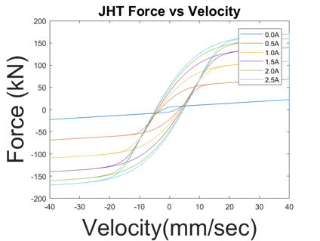
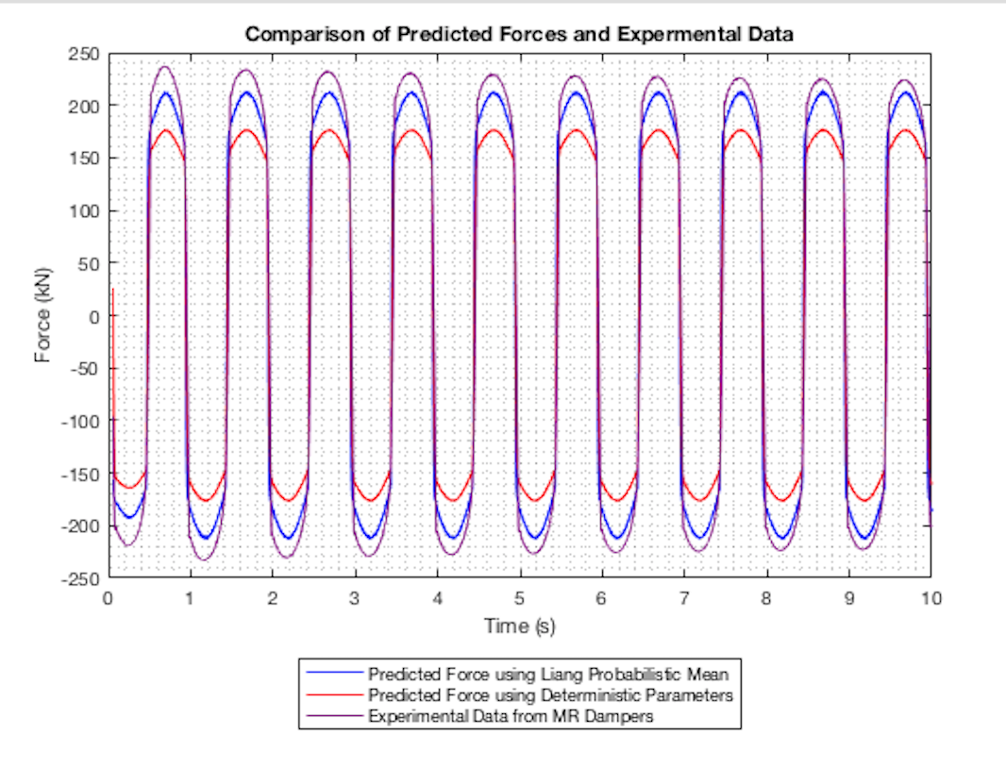
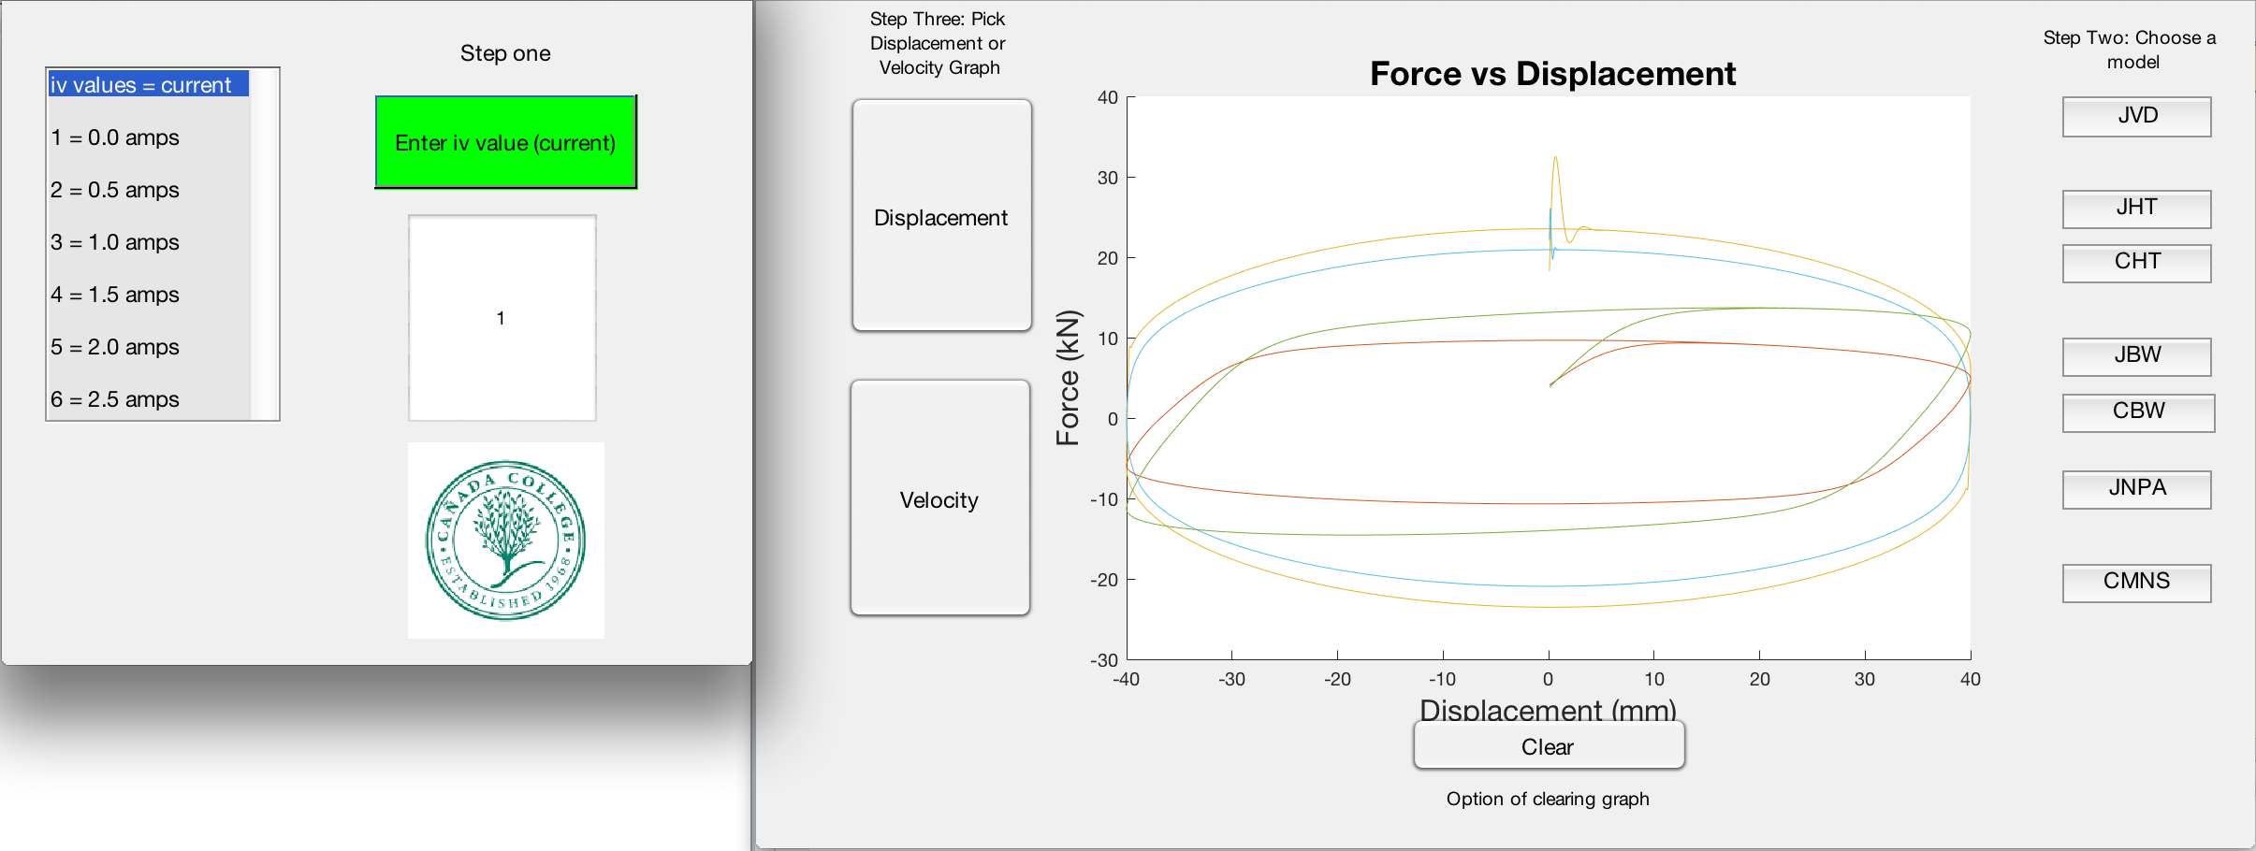
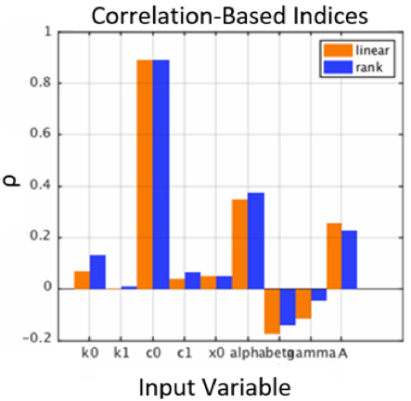
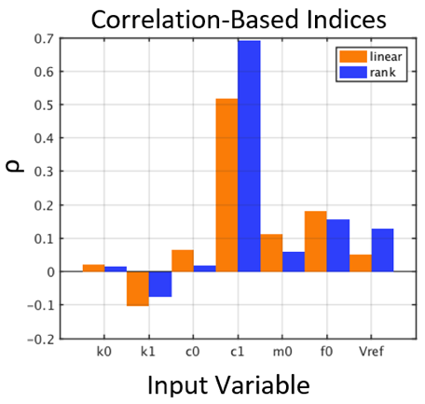
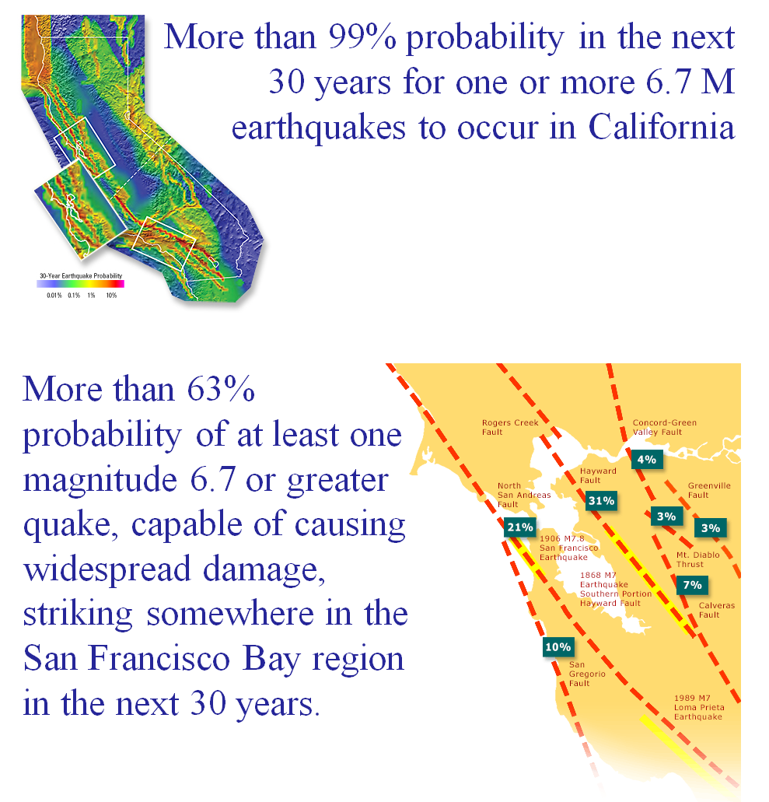
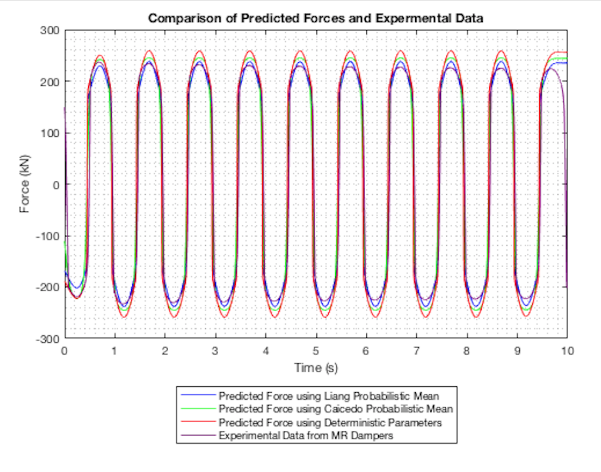
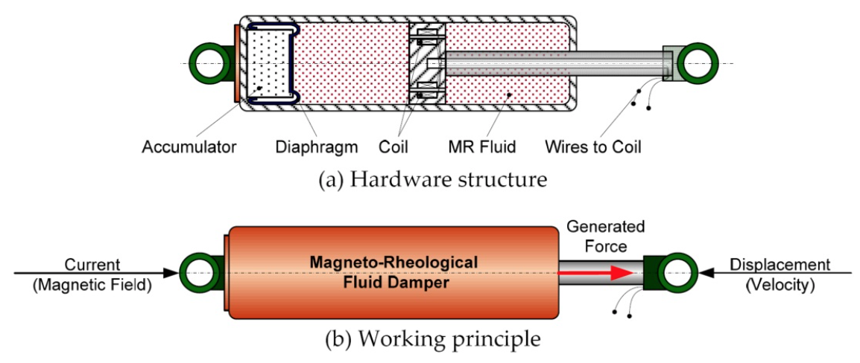
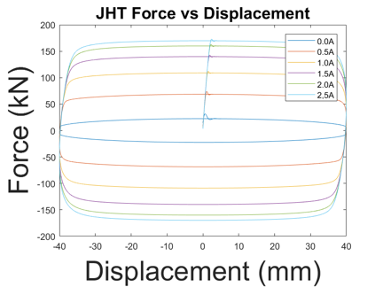
Comparison of 200kN Magneto-Rheological Dampers for Determination of Parameters by Probabilistic Means
Christopher Amaro, Priscila Silva, Adam Davies, Juvenal Marin, Jesus Caballero
Cañada College/San Francisco State University
ABSTRACT
METHODS
The state of California has many fault lines throughout the bay area and other densely populated areas that are prone to earthquakes. The 1989 Loma Prieta earthquake that caused around 6 billions dollars in damages. In order to prevent another huge disaster to our infrastructure, MR (Magneto Rheological) Dampers are being designed to dissipate energy from earthquakes. By analyzing different model types for the dampers, we are able to monitor their activity and reaction to optimize their performance. Using software like MATLAB and UQ Lab we have been able to conduct various experiments, and collect data that has been gathered to see how the dampers will react in a real-world application. Our results also will alert us to any errors that might happen in real world applications and see if there needs to be adjustments within formulas, and parameters. Our goals will help determine model parameters with probabilistic methods, and also compare/contrast models and respective parameters.
Figure 1: Fault Lines in Calfornia
Figure 2: Magneto-rheological damper and components
Graphic user interface
Research tool to compare plots was created
GUI function in MATLAB was used to create a plot comparison application
GUI takes user inputs to plot various MR damper models at different currents
Figure 5: Velocity vs Displacement for the Hyperbolic Tangent Model
UQ Lab (uncertainty quantification)
Parameter sensitivity charts were created with UQ Lab
Parameters with larger values indicate increased sensitivity within the respective MR damper model
Figure 3: Working GUI
Figure 9: Viscous Plus Dahl Metropolis-Hasting Algorithm Comparison of Predicted Forces and Experimental Data
Simulink was used to create differential equations in MATLAB with symbols
UQ Lab (Uncertainty Quantification) was used to find likeliness of outcomes associated with MR damper parameters
Metropolis-Hasting Algorithm used to find the probabilistic parameters of MR damper models
CONCLUSIONS
In our trials the probabilistic parameters were more precise than previously determined deterministic parameters
Further recommendations include analyzing parameters of additional MR damper models with the Metropolis-Hasting Algorithm
Future work includes studies involving single degree of freedom
Figure 6: Bouc-Wen model, the most sensitive variable is ‘c0’ while ‘k1’ is the least sensitive
Figure 7: Hyperbolic Tangent model, parameter ‘c1’ is the most sensitive while most of the other parameters are closer to zero and less sensitive
Metropolis Hasting Algorithm
Realistic mathematical modeling used to generalize experimental results
Plot of Non-Parametric Algebraic MR damper model displays Liang’s parameters closer to experimental data
Thus the probabilistic parameters are more precise than the deterministic parameters
Figure 8: Non Parametric Alegebraic Model Metropolis-Hasting Algorithm Comparison of Predicted Forces and Experimental Data
REFERENCES
RESULTS
Jiang, Z., and R. Christenson. "A Comparison of 200 KN Magneto-rheological Damper Models for Use in Real-time Hybrid Simulation Pretesting." Smart Materials and Structures 20.6 (2011): 065011. Web.
Chae, Yunbyeong, James M. Ricles, and Richard Sause. "Modeling of a Large-scale Magneto-rheological Damper for Seismic Hazard Mitigation. Part I: Passive Mode." Earthquake Engineering & Structural Dynamics 42.5 (2012): 669-85. Web.
Caicedo, Juan M., Zhaoshuo Jiang, and Sarah C. Baxter. "Including Uncertainty in Modeling the Dynamic Response of a Large-Scale 200 KN Magneto-Rheological Damper." ASCE-ASME Journal of Risk and Uncertainty in Engineering Systems, Part A: Civil Engineering 3.2 (2017): n. pag. Web.
D.Q. Troung and AhnK.K. “MR Fluid Damper and It’s Application to Force Sensorless Damping Control System.” Intech (2012): DOI: 10.5772/51391. Web
Liang, Jun Jian. "Comparison of Models for Large-Scale Magneto-Rheological Damper to Account for Uncertainty in Seismic Hazard Mitigation." Comparison of Models for Large-Scale Magneto-Rheological Damper to Account for Uncertainty in Seismic Hazard Mitigation (2018): 1-14. Web.
“USGS: California Has 99.7 Percent Chance of Big Earthquake in Next 30 Years.” Fox News, FOX News Network, 15 Apr. 2008, www.foxnews.com/story/2008/04/15/usgs-california-has-7-percent-chance-big-earthquake-in-next-30-years.html.
Truong, D. Q., and K. K. Ahn. “MR Fluid Damper and Its Application to Force Sensorless Damping Control System.” MR Fluid Damper and Its Application to Force Sensorless Damping Control System | InTechOpen, InTech, 17 Oct. 2012, www.intechopen.com/books/smart-actuation-and-sensing-systems-recent-advances-and-future-challenges/mr-fluid-damper-and-its-application-to-force-sensorless-damping-control-system.
Sidpara, Ajay. “Magnetorheological Finishing: a Perfect Solution to Nanofinishing Requirements.” Optical Engineering, International Society for Optics and Photonics, 1 Sept. 2014, opticalengineering.spiedigitallibrary.org/article.aspx?articleid=1857354.
Jiang, Zhaoshuo, et al. “Application of MR Damper in Real-Time Structural Damage Detection Using Extended Kalman Filter.” ResearchGate, 10 Aug. 2015,
www.researchgate.net/figure/281792403_fig2_Figure-31-Schematic-of-the-MR-damper-hyperbolic-tangent-model. “Uncertainty Quantification.” Uncertainty Quantification | SmartUQ, www.smartuq.com/resources/uncertainty-quantification/.
Simulink
Force vs Displacement represents the displacement of piston housed within the respective MR damper model
Six closed curves correspond to the six input currents in MR damper
Area in each closed curve represents the amount of energy dissipated by the respective MR damper model
Force vs Velocity represents velocity of piston housed in MR damper
Force becomes saturated after reaching maximum point while velocity continues to increase
INTRODUCTION
Structural engineering concerns itself with the safety and failure prevention of structures
The state of California is prone to experiencing earthquakes
Magneto-rheological dampers can be used in structural damage mitigation
Figure 4: Force vs Displacement for the Hyperbolic Tangent Model
Acknowledgements
This project is supported by the US Department of Education through the through the Minority Science and Engineering Improvement Program (MSEIP, Award No. P120A150014); and through the Hispanic-Serving Institution Science, Technology, Engineering, and Mathematics (HSI STEM) Program, Award No. P031C110159.

