Slide 1
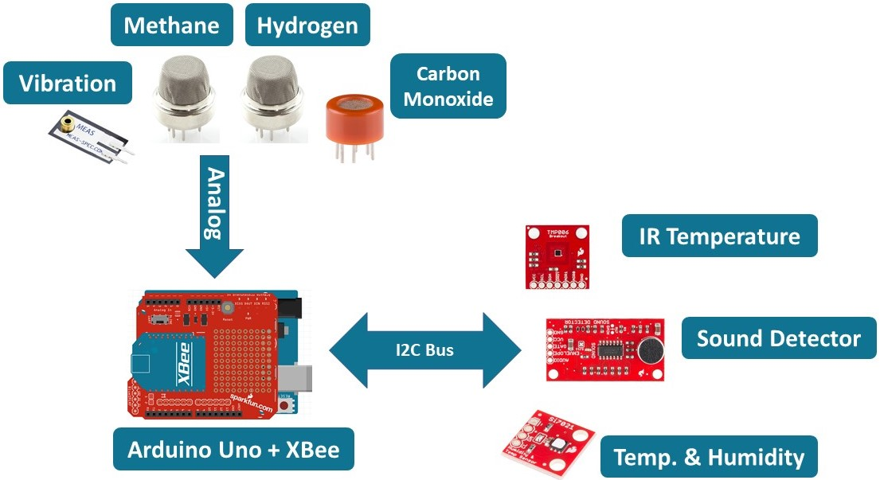
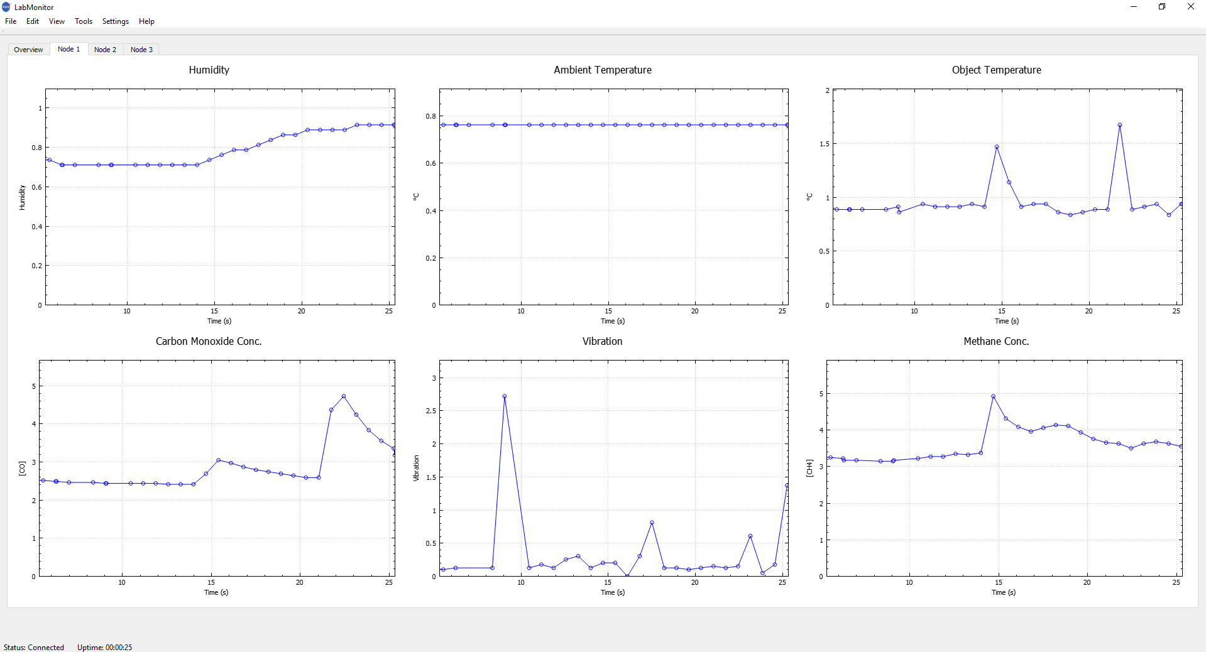
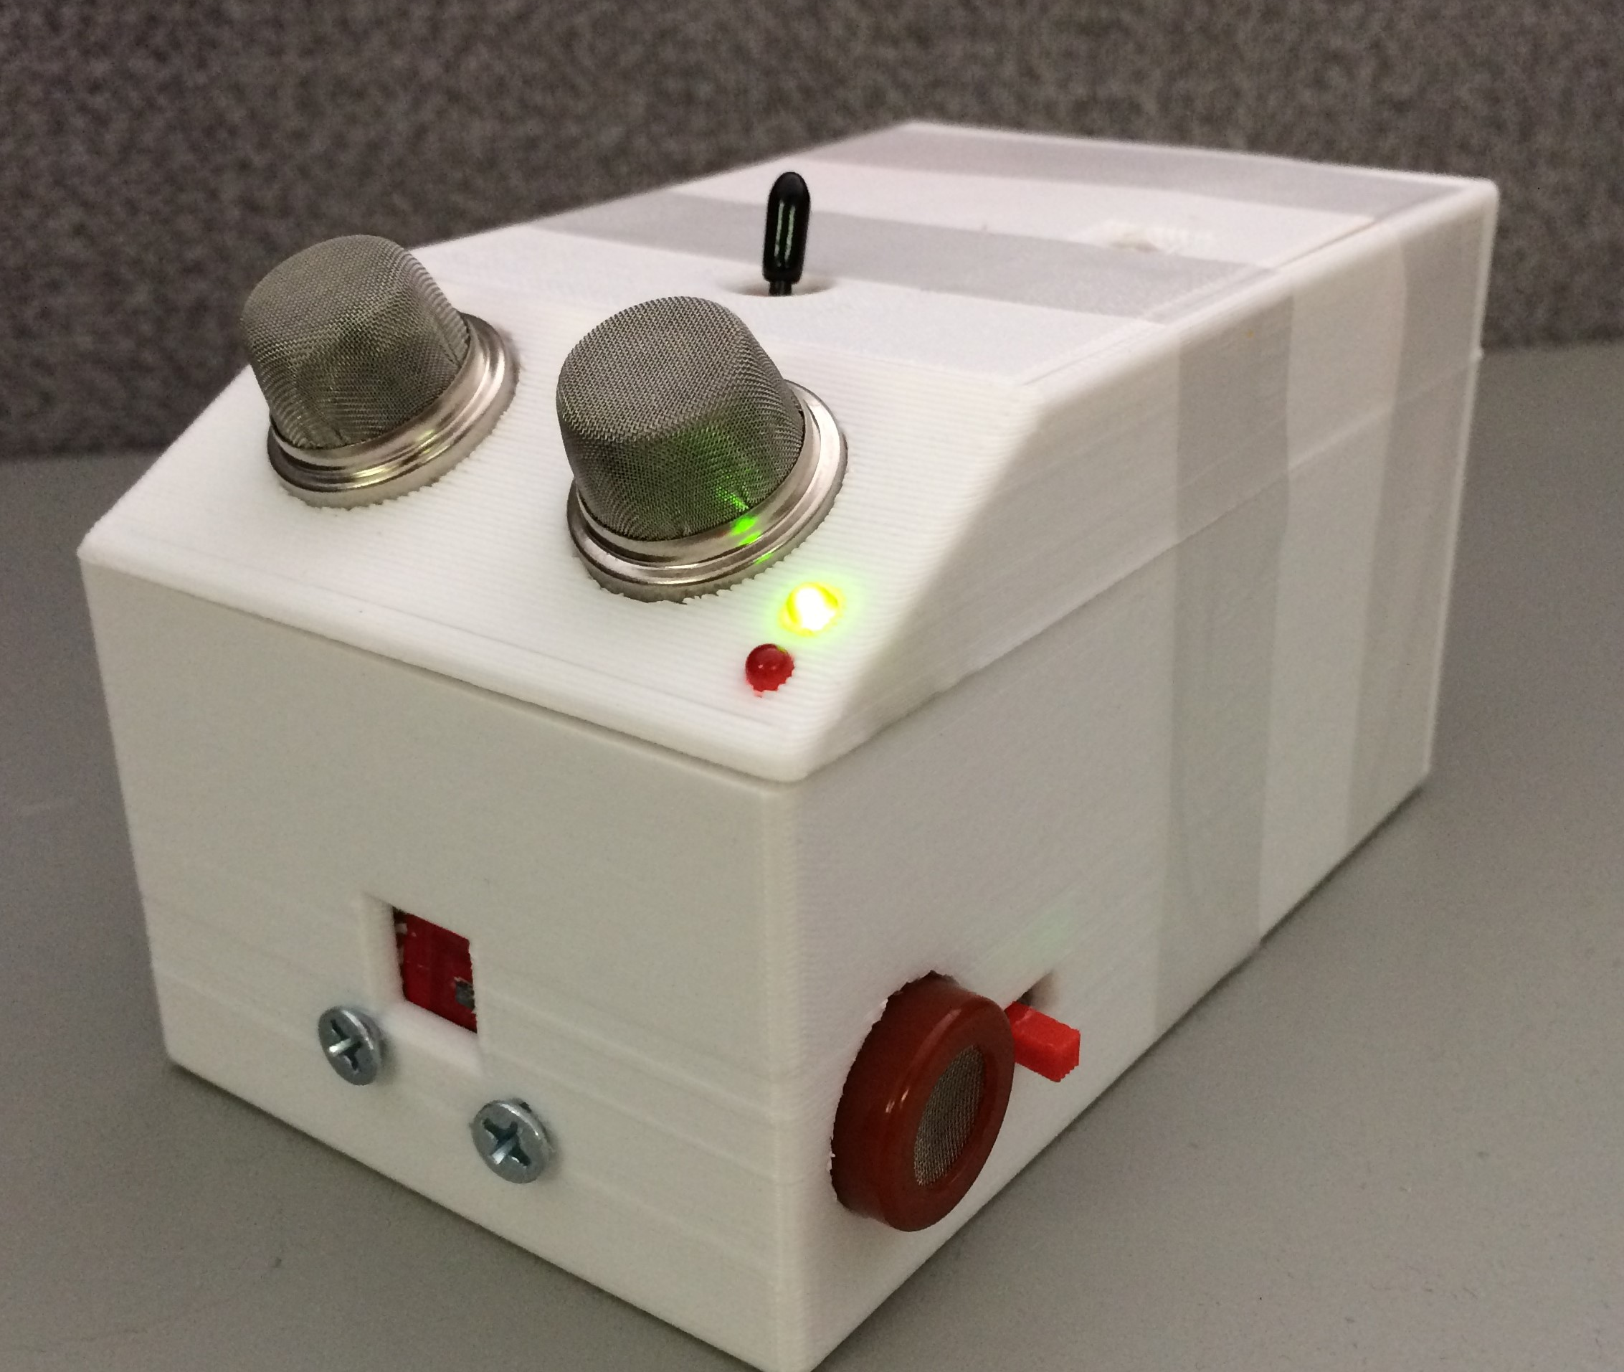
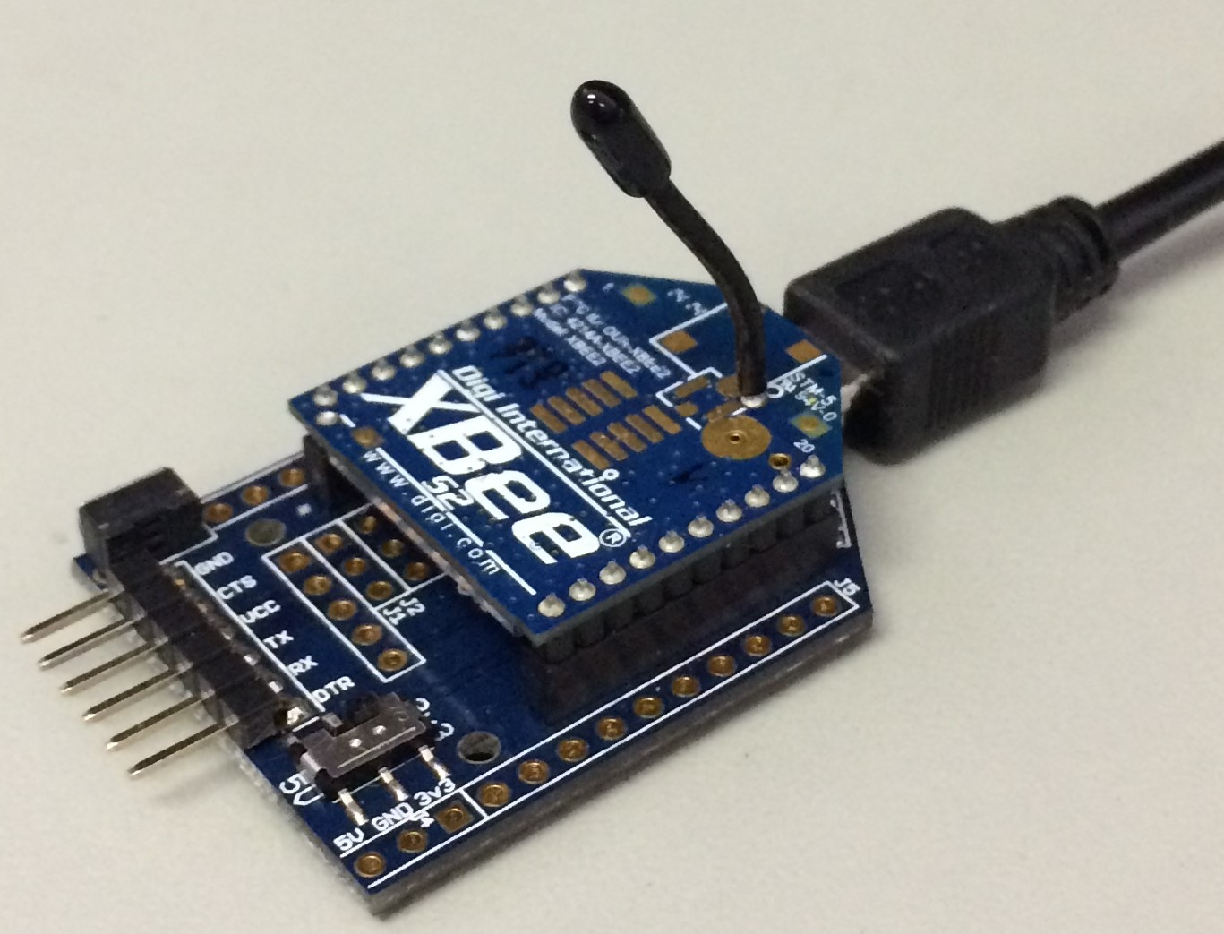
LabMonitor: An Open-Source and Low-Cost Smart Laboratory Monitoring System to Ensure Laboratory Environmental Safety
Author: James L. Dalton¹ Mentors: George E. Gorospe¹, Christopher Teubert¹ ¹Prognostics Center of Excellence, NASA Ames Research Center, Moffett Field, CA
Introduction
II. Design and Implementation
Objective: Design, implement, and deploy a system of wireless sensor nodes for situational awareness, remote monitoring, data logging, and issuing alerts.
Motivation: Many laboratories, testing facilities and experiments operate under uncertain environmental conditions that could create biases in the resulting data or may be harmful to laboratory personnel. The LabMonitor is a simple-to-use system that provides situational awareness, remote monitoring, and automated alerts to ensure environmental safety.
Advantages:
Low-cost, ~$100 per node
Easily interchangeable sensor array
Customizable user interface
Scalable node fleet and range of communication
Cross-platform display application
Open-Source node design and software
Figure 2: Sample node layout.
Figure 5: Base computer user-interface.
IV. Future Work
Implement web server to record up to 48 hours of sensory data in a MySQL database
Website for displaying and monitoring
Cell phone and email alerts
Figure 3: Node prototype in 3D printed enclosure.
Figure 4: Base computer XBee™ radio.
III. Educational Outcomes
Acknowledgements
I would like to acknowledge and thank my mentors, George Gorospe and Chris Teubert, along with Dr. Wendy Okolo for their guidance and advice throughout the duration of this project. I would also like to thank my advisor, Dr. Amelito Enriquez. This project was funded by a grant from the U.S. Dept. of Education, Grant No. P120A150014.
Skills I learned throughout this opportunity
Qt C++ framework
XBee™ API wireless communication
Prototyping
Autodesk Inventor® 3D CAD
MySQL databases
Graphical user interface design
References
Faludi, Robert. Building Wireless Sensor Networks. N.p.: O'Reilly Media, 2010. Print. Blum, Jeremy. Exploring Arduino. Indianapolis, IN: John Wiley, 2013. Print.
Pocock, Anthony. Qt XBee API Library. Github.com. N.p., n.d. Web. 3 July 2017.
Figure 1: High-level overview of project.
Photo Credit: George Gorospe
Notes:
LabMonitor Poster: white, horizontal

