Slide 1
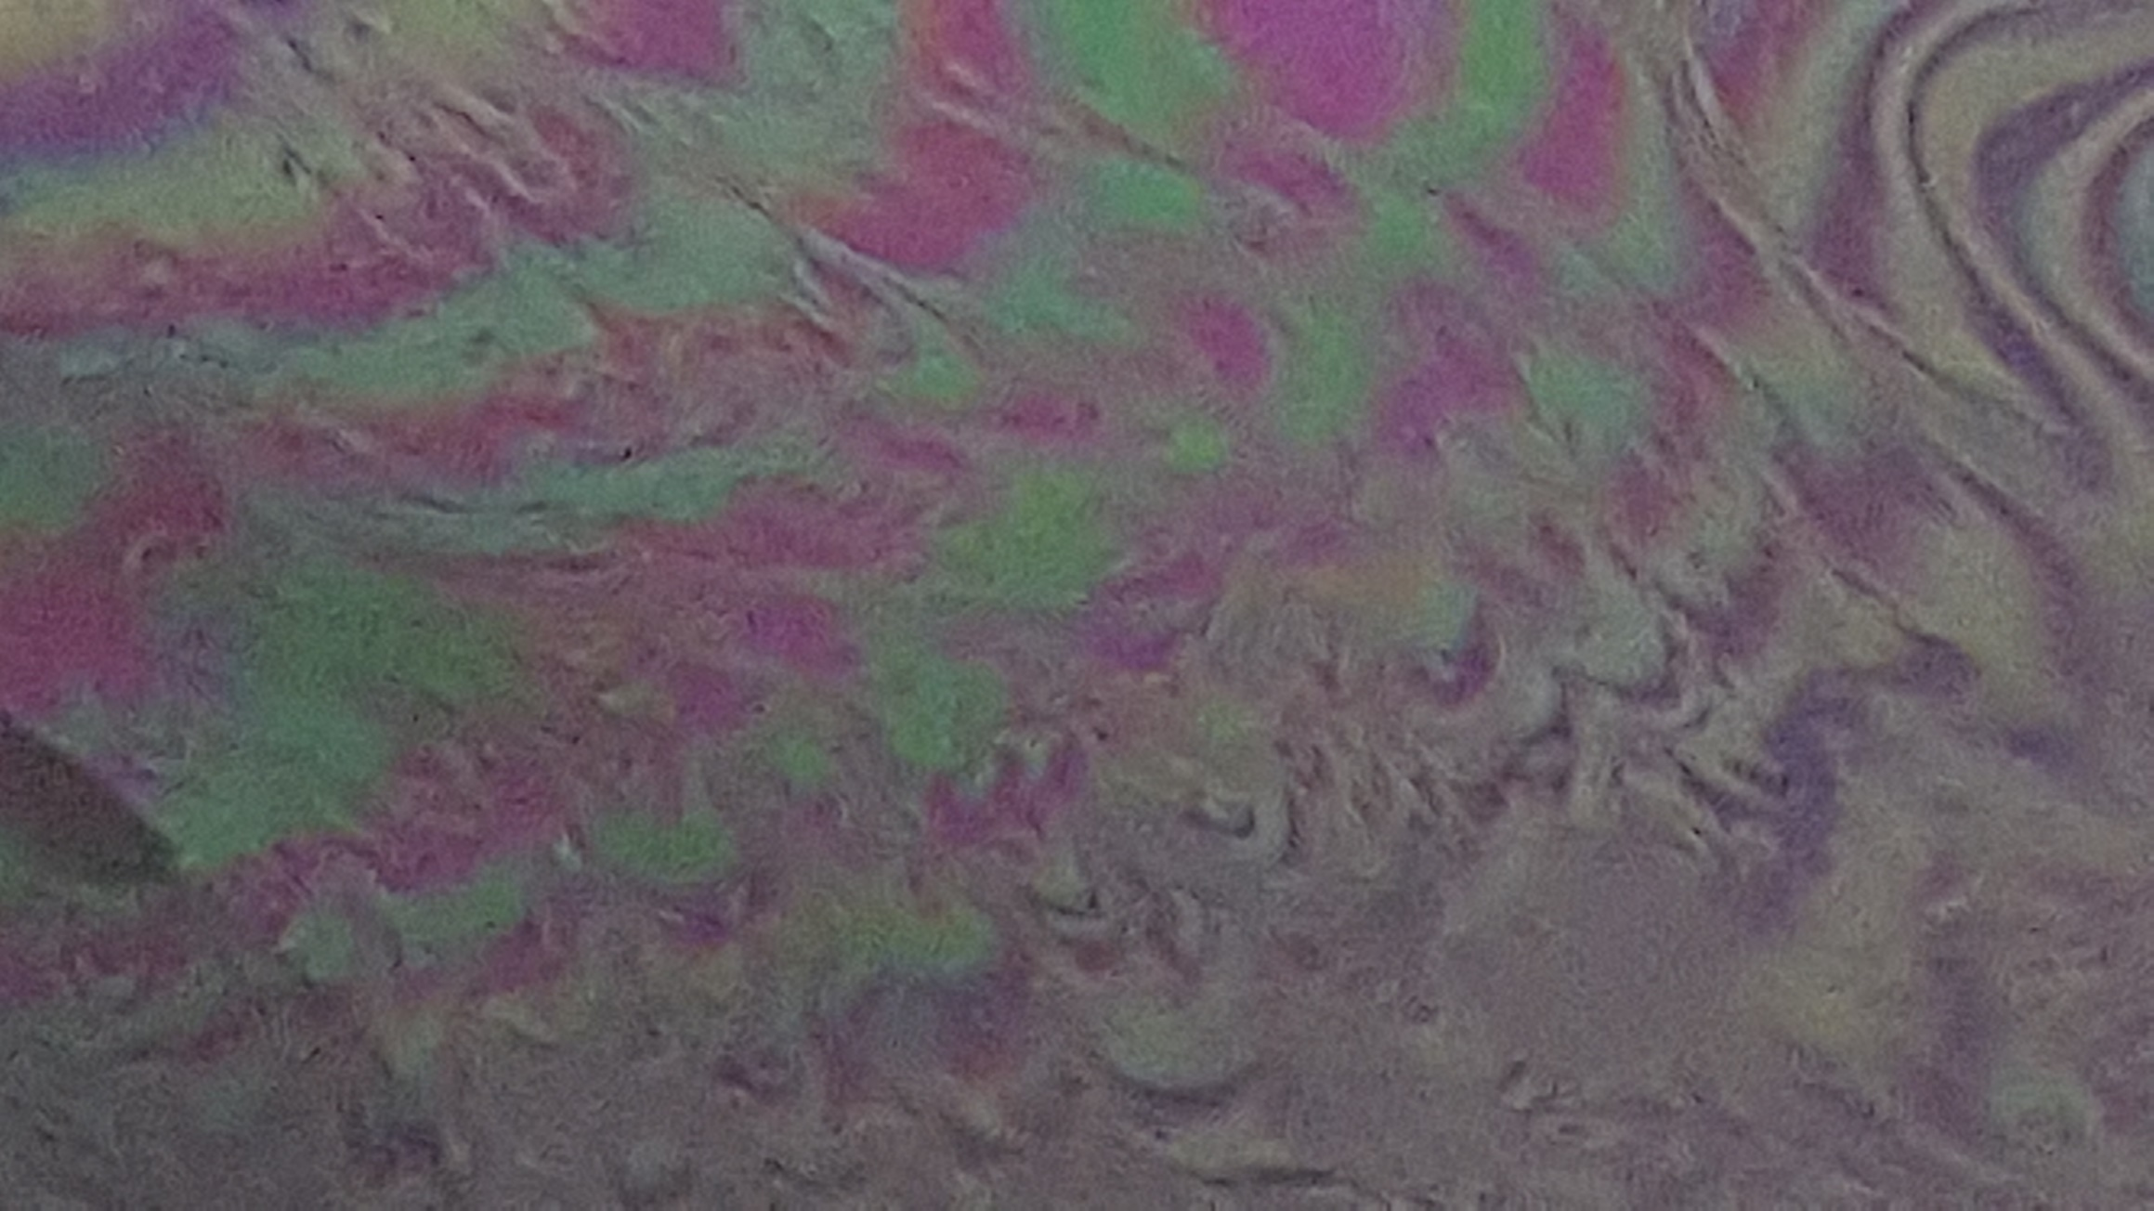
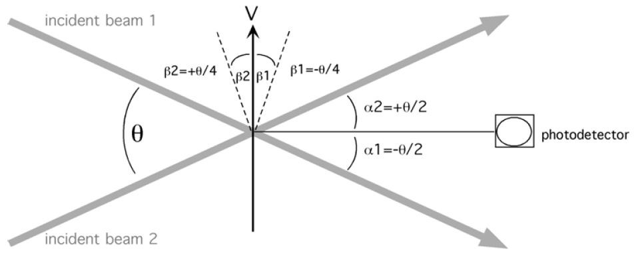
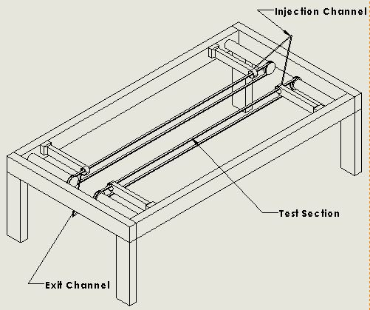
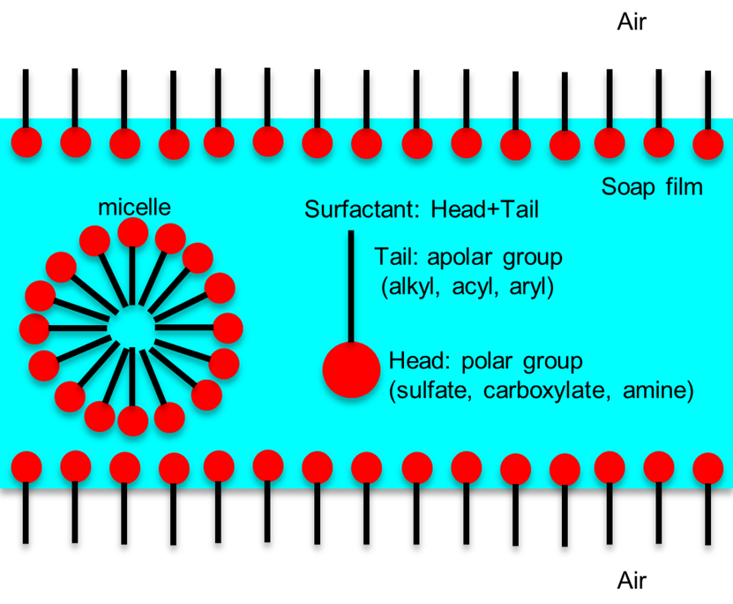
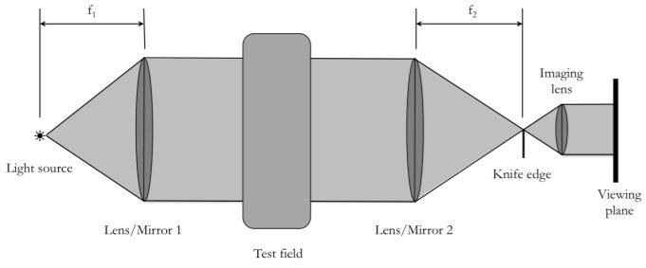
Experimental Approach to 2-Dimensional Horizontal Flow Phenomena in Thin Films
Jesse Sanchez, Yanbao Ma, Krishna Shah
School of Engineering, University of California, Merced
Introduction
Materials & Methods
Flow Visualization
Laser Doppler Velocimetry
There exists a sharp divide in fluid mechanics between theoretical modeling of flow behavior and the flow behavior found in natural environments or engineered applications. This disconnect is due to an idealized approach to theoretical models associated with fluid flow. One of the chief obstacles to workable theory is the action of viscosity to which a destabilizing effect occurs within the fluid. This effect gives rise to a disorderly, random phenomena called turbulence. Theory of turbulent flow is heavily supported by experimental analysis as idealized models do not account for the chaotic fluctuations in flow behavior. This experimental approach utilizes horizontal soap films as physical approximations to the concept of a 2-dimensional fluid to analyze flow phenomena relating to turbulence. Experimental studies of 2-dimensional flow have significant implications on vortex dynamics related to oceanic and atmospheric analysis, 2-dimensional turbulence, and transition mechanisms in shear flow.
Soap Films
Thin slab of water protected by two monolayers of surfactant molecules possessing amphipathic properties
Fig. 1: Configuration of a soap film with a thin sheet of flowing water between two layers of surfactant molecules.
Surfactants endow film with an elasticity against local thinning that could lead to rupture
Soap solution must be above critical micelle concentration to retain constant surface tension
Marginal regeneration occurs where film contacts wires allowing soap film to cling to rigid bodies
Two surface layers have a liquid-like behavior moving together with the interstitial liquid
Laminar flow induced in film through a precise control of flow velocity
Film is considered 2-dimensional as film tunnel consists of a width that is greater than 10⁵ times its thickness
Medium for studying relationships between laminar and turbulent flow when experiencing various conditions
Optical interference between surfaces of film allow for flow visualization
Density variations within film determined using Schlieren Imaging Technique
Flow velocity of film determined using Laser Doppler Velocimetry
Methods
Optical interference between surfaces of the film provide color variations to occur within the channel
Thickness variations in film are visible as dark and bright fringes
Contrast variations act as a tracer for the flow occurring within the film
Quarter wavelength change in film thickness (~ 0.1μm for water) changes interference condition from constructive to destructive
Fig. 3: Color bands produced due to thin film interference of incident light rays transitioning between constructive and destructive interference
Schlieren Imaging Technique utilizes sets of concave mirrors, a light source, and a knife edge to magnify these visual effects to determine thickness variations in transparent media
Fig. 4: Schematic of Schlieren setup
Thickness variations in thin films relate directly to 2D Navier-Stokes Equations
Navier-Stokes equations along with the continuity equation predict fluid velocity and its pressure in a given geometry
$\frac{∂u}{∂x}+\frac{∂v}{∂y}=0$ continuity eq.
2D Navier-Stokes Equations
$\frac{∂u}{∂t}+u\left(\frac{∂u}{∂x}\right)+v\left(\frac{∂u}{∂y}\right)=−\frac{∂p}{∂x}+v\left(\frac{∂^{2}u}{∂x^{2}}+\frac{∂^{2}u}{∂y^{2}}\right)$
$\frac{∂v}{∂t}+u\left(\frac{∂v}{∂x}\right)+v\left(\frac{∂v}{∂y}\right)=−\frac{∂p}{∂y}+v\left(\frac{∂^{2}v}{∂x^{2}}+\frac{∂^{2}v}{∂y^{2}}\right)$
$u=dynamic viscosity$ (Pa*s)
$v=flow velocity (\frac{m}{s})$
$p=pressure$ (Pa)
Laser Doppler Velocimetry (LDV) is a non-intrusive optical technique used to obtain 2D point measurements of velocity and turbulent distribution
Measures velocity at scattering volume by analyzing doppler shift in frequency of light passing through film
Produces graphical representation of the mean velocity profile measured across test section
Film plane kept at an angle with respect to LDV optical axis to ensure reflected light from film surface bypasses LDV collection optics
Fig. 5: Configuration of setup for LDV system
Doppler shift depends on flow velocity ($v$) , wavelength of light ($λ$), and the orientation of the observer
$\frac{\left|f_{D1} −f_{D2}\right|}{2}=\frac{2V}{λ}\cos\left(\frac{θ}{4}\right)\sin\left(\frac{θ}{4}\right)=\frac{2V}{λ}\sin\left(\frac{θ}{2}\right)$
Soap solution is a mixture of 1-2% Dawn dishwashing soap and 98-99% distilled water
Injection nozzle consists of 20 mL tube connected to an 18 gauge nozzle, ½ “ in length
Braided polymer line of .06 mm diameter is threaded through the nozzle and anchored in a reservoir of solution
Injection lines 30 cm long are connected to a rigid support system and angled at 45° above horizontal
Monofilament fishing wire of 0.5 mm diameter is connected in a closed loop around motorized pulley system forming a 55 cm long, 5 cm wide test channel
Exit channel 30 cm in length is connected to support system and angled at 45° below horizontal to allow a laminar flow to occur within the film
Film is applied via squeegee and fed solution through the injection system to allow uniform flow through the test section
Fig. 2: Prototype apparatus for controlling flow within a horizontal thin film using electro-motorized guide wires, threaded through a set of supporting bars to which injection and exit channels are attached.
Results & Conclusions
Soap film tunnels have great potential for understanding 2D flow phenomena
Soap solution diluted below 1% does not produce critical micelle concentration; however, higher soap concentrations lead to non-uniform films
Fluid in film separates at low flow rates (films < 1 m/s exhibit violent instabilities)
Faster flow rates suppress marginal regeneration, possibly due to high shear rates near guide wires
Flow speeds range between 0.5 – 5 m/s depending on angle of inclination for injection channel and the speed of the motorized guide wire system
As flow rate increases, film thickness increases, and transverse wave speed decreases. When film speed exceeds wave speed, shock waves appear which lead to rupturing of film
Further analysis should be designed to address issues of fluid dynamics regarding turbulent production in boundary layers, mixing processes in shear flows, 2D turbulence, and vortex dynamics
Turbulence
Chaotic changes in pressure and flow velocity
Characterized by erratic, small, whirl-pool like circles called “eddy currents” or “eddies”
Eddies absorb a great deal of energy as eddies created at a small energy injection scale, r_{inj}, cluster and merge into larger eddies through interaction by cannibalization (Kraichnan’s Inverse Energy Cascade)
Reynold’s Number (Re) used to predict flow patterns in various flow situations where a high Re indicates a turbulent flow and a low Re for laminar flow:
$Re=\frac{inertial force}{viscous force}=\frac{ρvL}{μ}$
$Re=Reynolds Number \left(unitless\right)$
$ρ=fluid density \left(\frac{kg}{m^{3}}\right)$
$v=velocity \left(\frac{m}{s}\right)$
$L=characteristic length \left(m\right)$
$μ=viscosity of fluid (Pa ∗s)$
Limitations
Experimental verification on horizontal films difficult to establish due to challenges in isolating 2D flow from evolving 3D instabilities.
References
Gharib, Morteza, and Philip Derango. “A Liquid Film (Soap Film) Tunnel to Study Two-Dimensional Laminar and Turbulent Shear Flows.” Physica D: Nonlinear Phenomena, vol. 37, no. 1-3, 1989, pp. 406–416., doi:10.1016/0167-2789(89)90145-0., pp. 406–416., doi:10.1016/0167-2789(89)90145-0.
Durst, F., A. Melling, and J. Whitelaw. 1981. Principles and Practices of Laser-
Doppler Anemometry. Academic Press.
Jia, Laibing. “Interaction Between Two Parallel Plates in Flow.” The Interaction Between Flexible Plates and Fluid in Two-Dimensional Flow Springer Theses, 2014, pp. 53–71., doi:10.1007/978-3-662-43675-2_4.
Notes:
Along with navier stokes eq. account for boundary conditions (otherwise it is assumed we have stationary walls)

