Slide 1
An Experimental Approach to 2-Dimensional Horizontal Flow Phenomena in Thin Films
Jesse Sanchez, Krishna Shah, Yanbao Ma
School of Engineering, University of California, Merced
ASPIRES
Notes:
Introduction

Slide 2
Overview
Measurement techniques
Methods
Introduction to Soap films
References
2-dimensional flow
Future research
Turbulence
Notes:
Breakdown

Slide 3
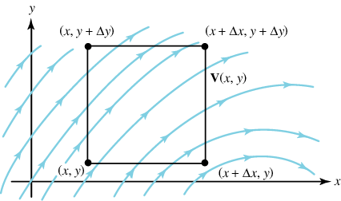
2-Dimensional flow
Fluid domain much smaller in one direction than the other two
Flow velocity at every point parallel to fixed plane
Stratified fluids
flow in confined spaces
Notes:
Fundamentals of 2D flow and its various applications. (what is it? Why should I care?)

Slide 4
2-Dimensional flow
Fluid domain much smaller in one direction than the other two
Flow velocity at every point parallel to fixed plane
Stratified fluids
flow in confined spaces

Slide 5
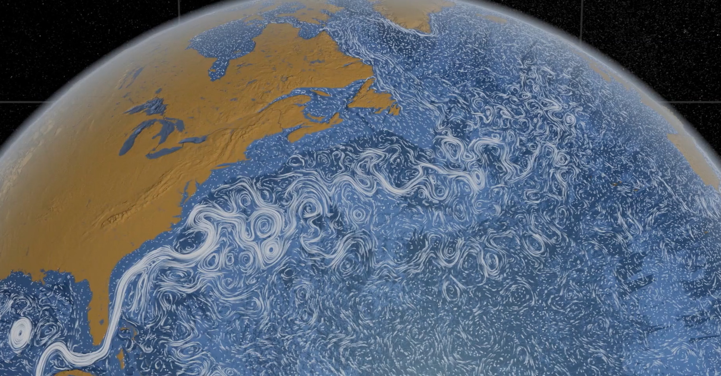
2-Dimensional flow
Fluid domain much smaller in one direction than the other two
Flow velocity at every point parallel to fixed plane
Stratified fluids
flow in confined spaces
Notes:
What is it and why should I care?

Slide 6
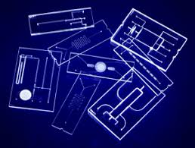
2-Dimensional flow
Fluid domain much smaller in one direction than the other two
Flow velocity at every point parallel to fixed plane
Stratified fluids
flow in confined spaces
Notes:
What is it and why should I care?

Slide 7
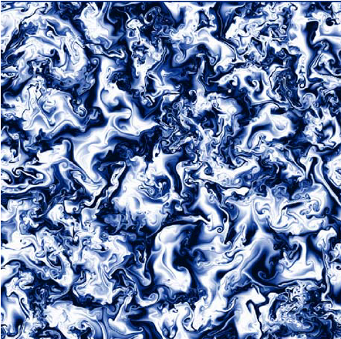
2-Dimensional flow
Fluid domain much smaller in one direction than the other two
Flow velocity at every point parallel to fixed plane
Stratified fluids
flow in confined spaces
Notes:
Diagram: flow through a given region in eulerian coordinates for incompressible viscous fluid Atmospheric analysis: thickness few tens of kilometers; however, lateral extent ranges to the tens of thousands km. advance science behind hurricane intensity forecasting Oceanography: ocean currents / flow patterns microfluidics: lab on a chip – support rapid developments in bio and biotech where manipulating small scale volumes is advantageous plasma: electron magnetohydrodynamic turbulence

Slide 8
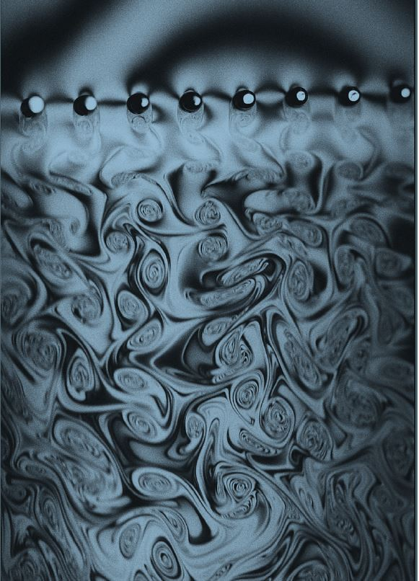
Turbulence
Chaotic changes in pressure & flow velocity
Characterized by erratic, eddy currents or “eddies”
Eddies cluster & merge into larger eddies via cannibalization
Turbulent flows occur in nature & created in engineering applications
Notes:
Strong connection between turbulence, flow velocity, viscosity, (above certain speed flow becomes turbulent).

Slide 9
navier-stokes equations
http://www.claymath.org/millennium-problems/navier%E2%80%93stokes-equation
Notes:
Mathematical model that describes the way an incompressible viscous fluid flows, must consider boundary conditions to solve these equations, and solve along with continuity equation [Navier-Stokes existence and smoothness problem]

Slide 10
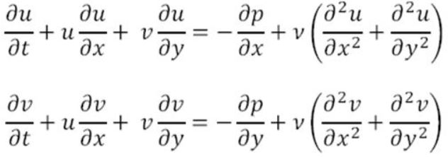
navier-stokes equations
http://www.claymath.org/millennium-problems/navier%E2%80%93stokes-equation

Slide 11
Soap films
thin sheet of water protected by two monolayers of surfactant molecules
Surfactants endow film with elasticity
Marginal regeneration allows film to cling to rigid bodies
Surface layers exhibit liquid-like behavior moving with interstitial fluid
Notes:
Transition to medium we will be using for 2D flow analysis : soap films

Slide 12
Design process

Slide 13
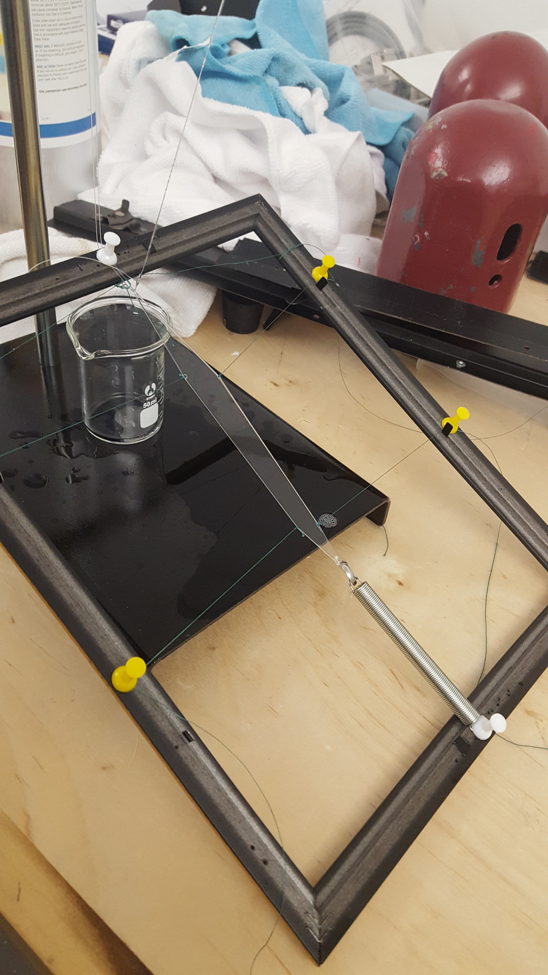
Design process

Slide 14
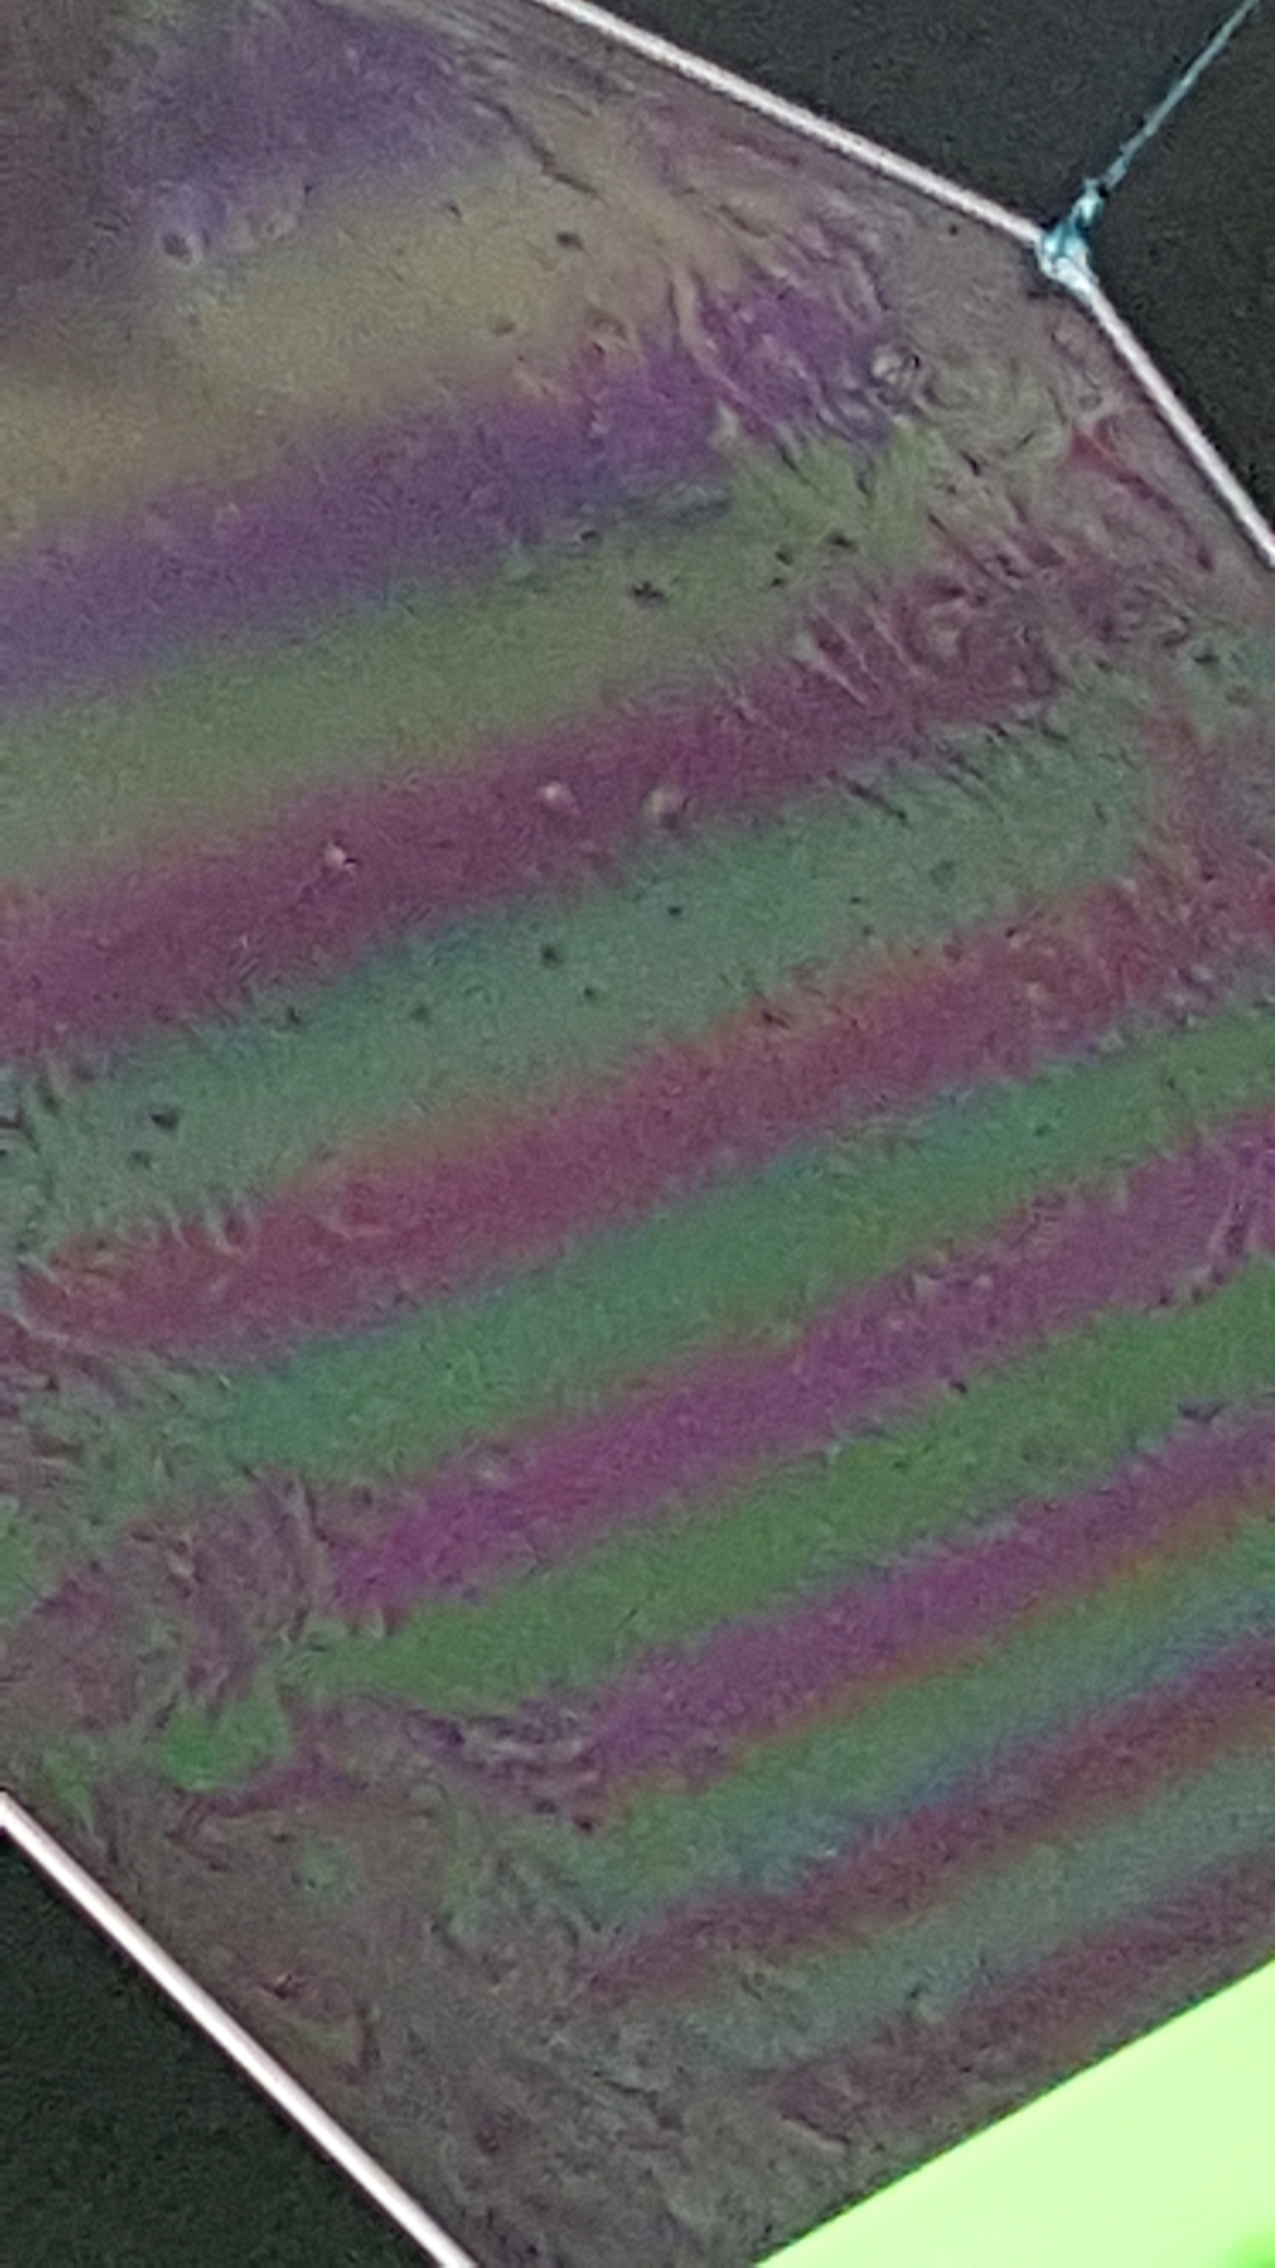
Design process

Slide 15
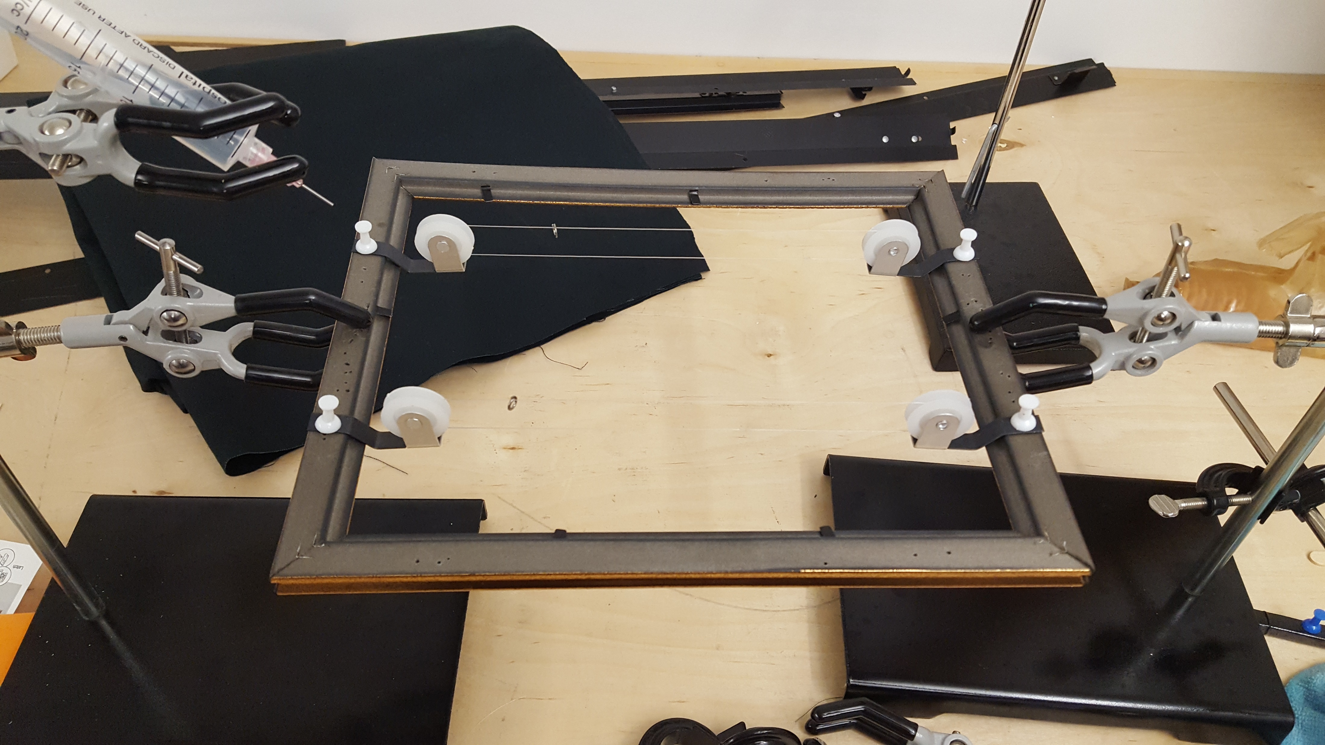
Design process

Slide 16
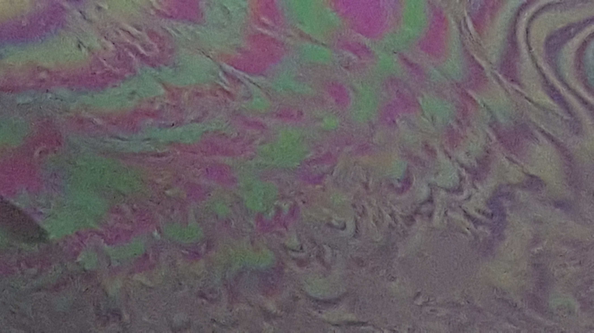
Design process

Slide 17
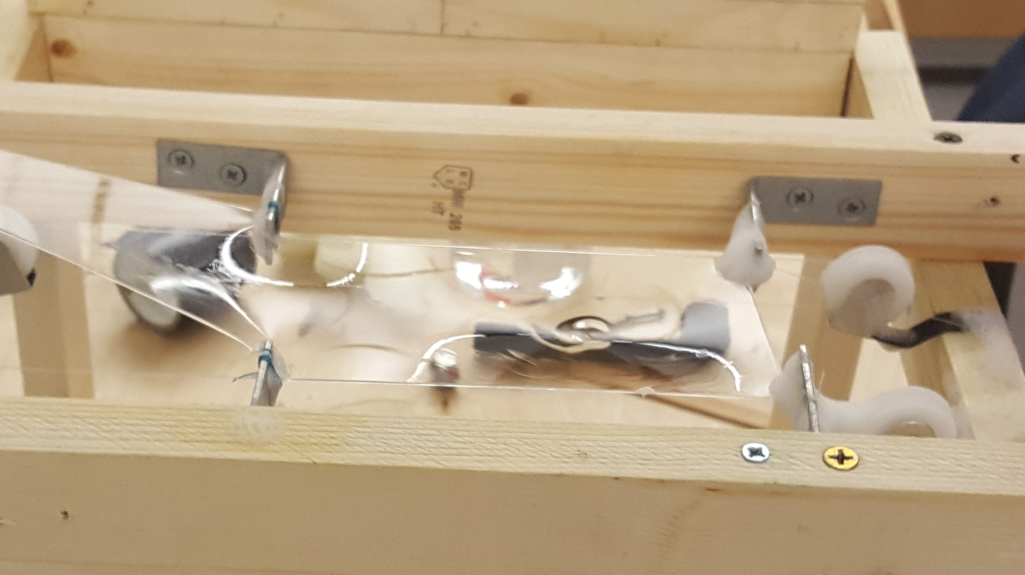
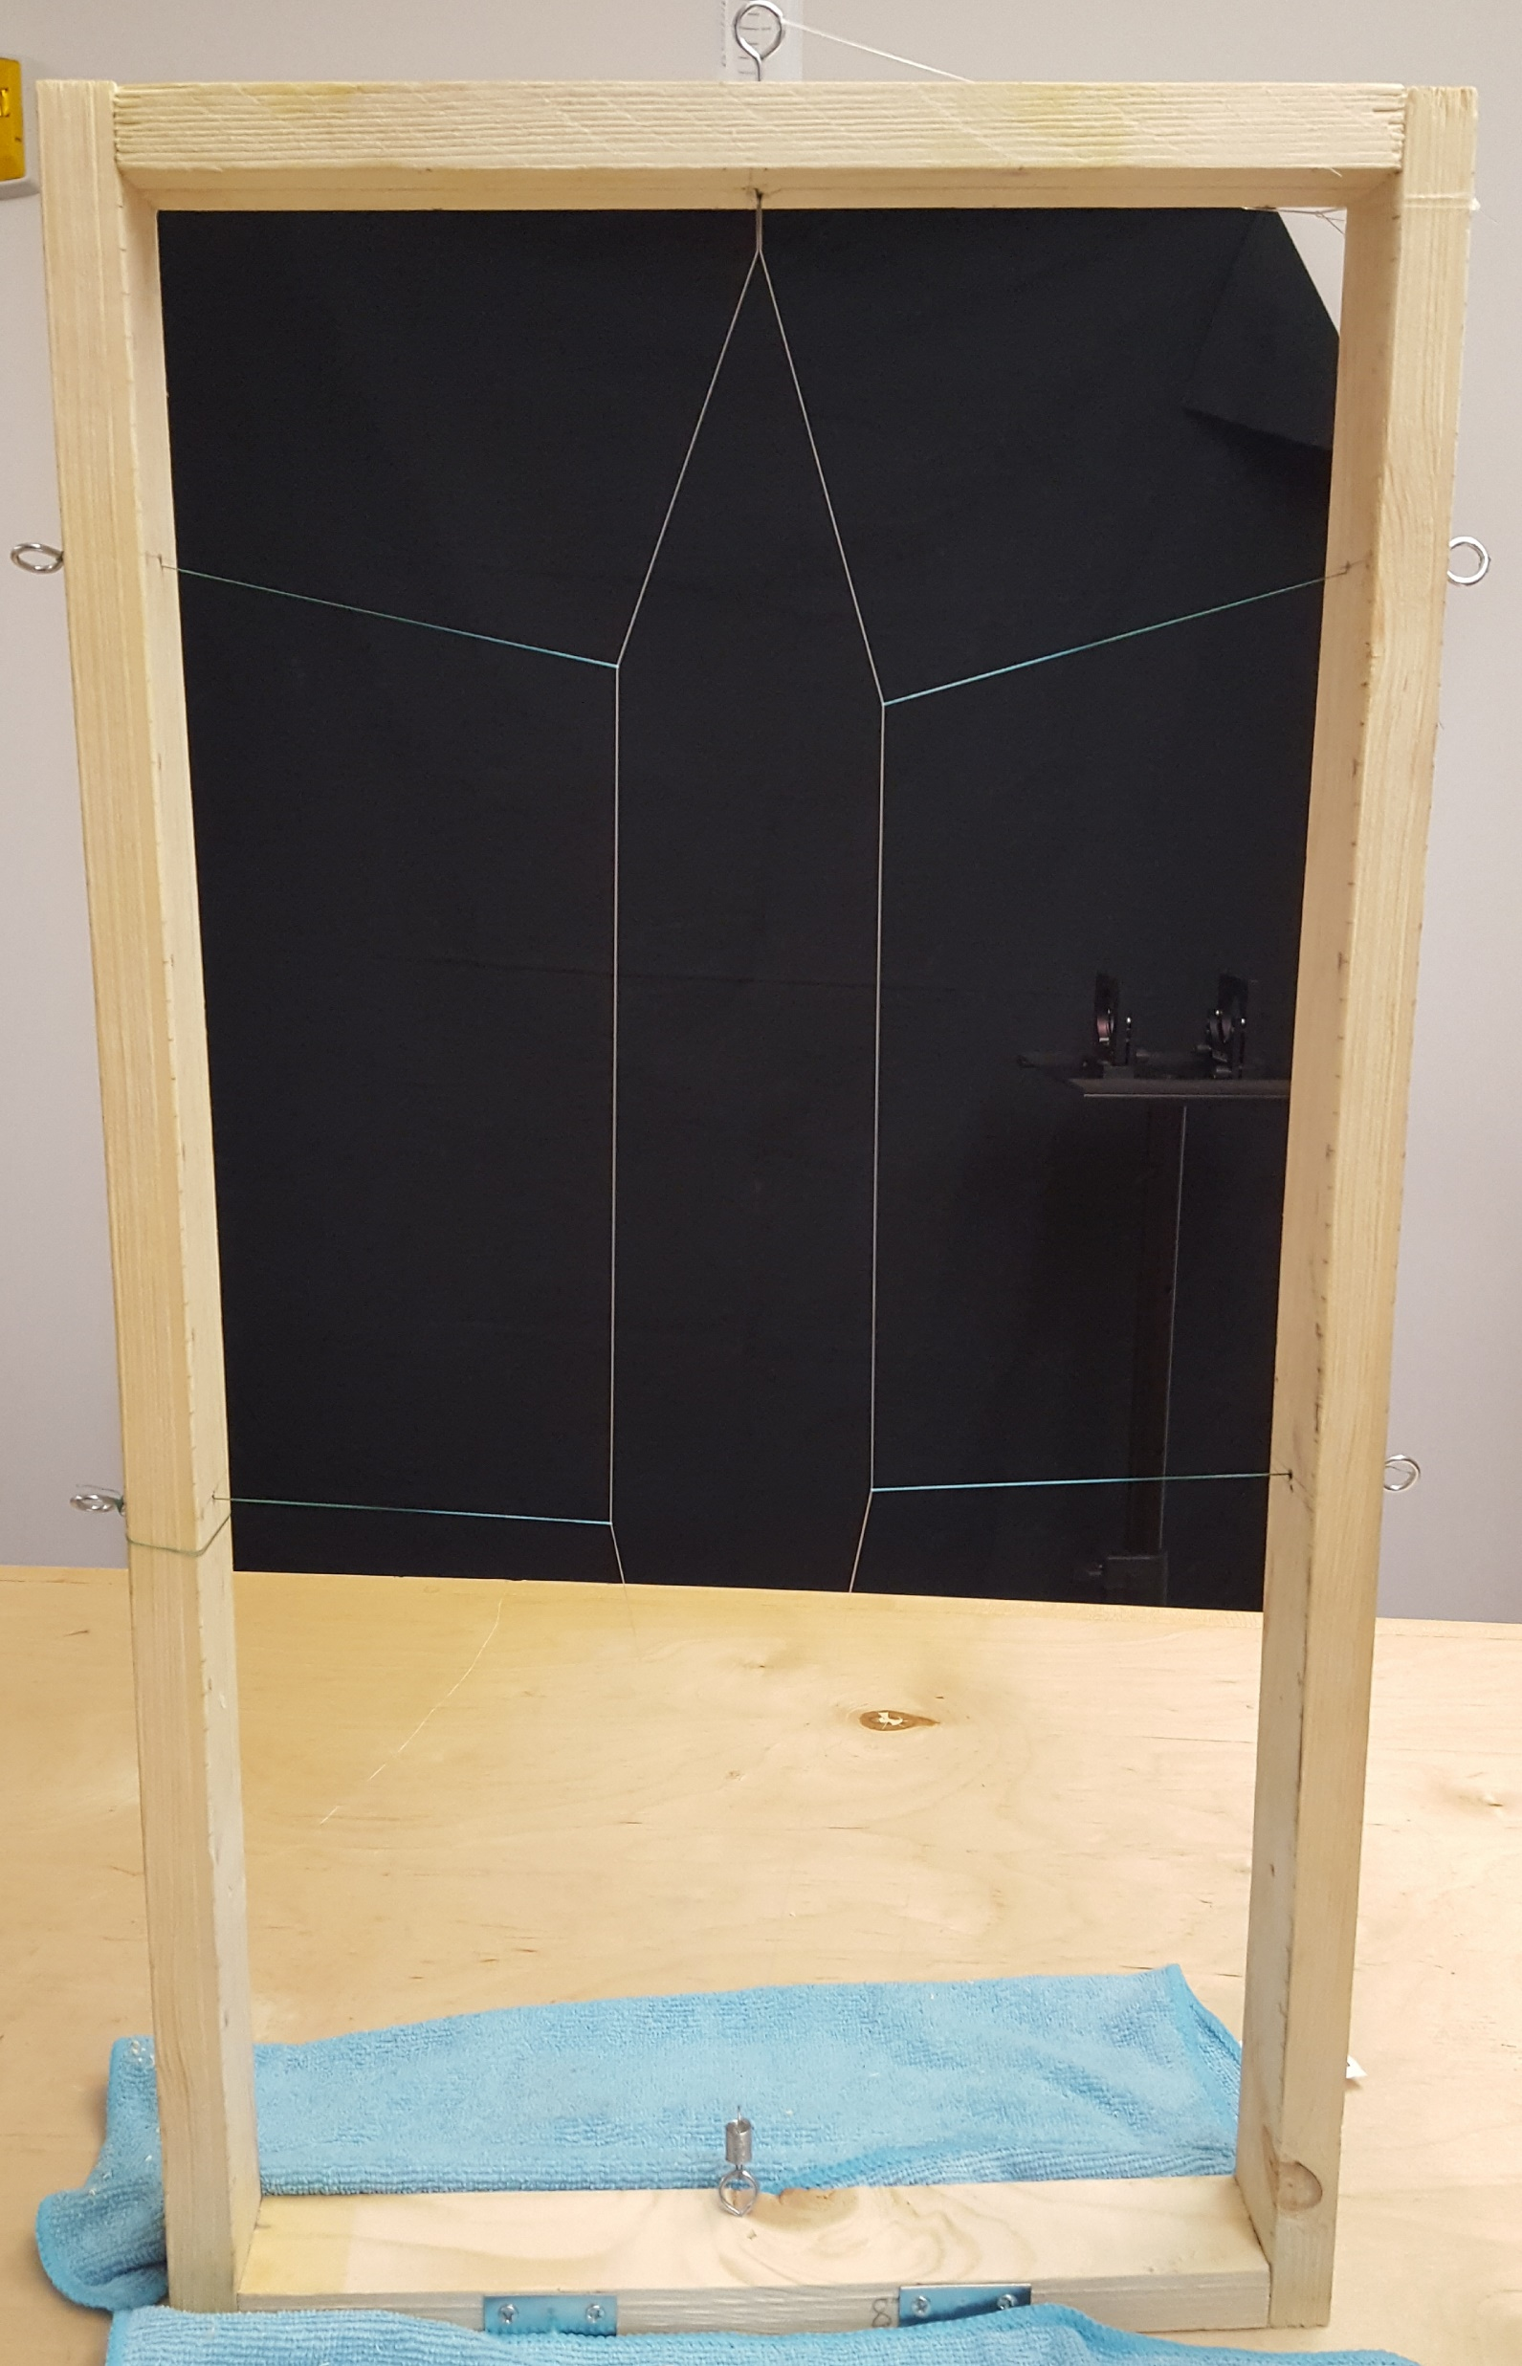
Design process

Slide 18
Design process

Slide 19
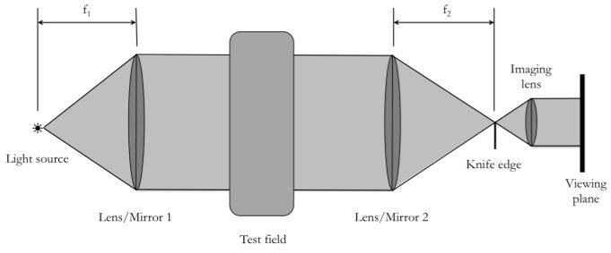
Schlieren imaging technique
Magnifies visual effects
High degree of spatial resolution
Used to detect change in refractive index
Analyze thickness variations in film
Notes:
Sets of concave mirrors

Slide 20
Laser doppler velocimetry (ldv)
Non-intrusive optical technique
Obtains 2-dimensional point measurements of velocity
Analyzes doppler shift in laser beam to determine velocity
Notes:
Scattering volume and point source

Slide 21
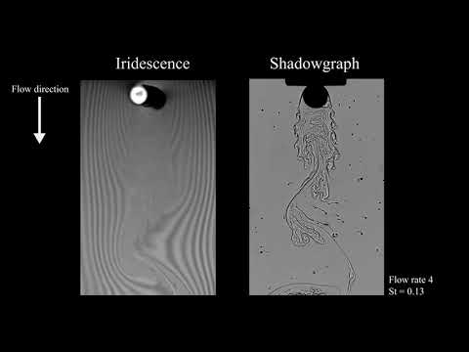
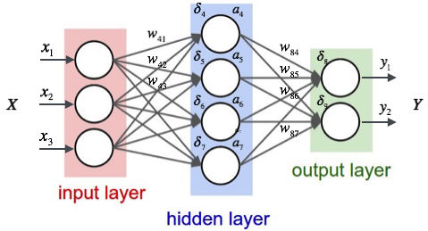
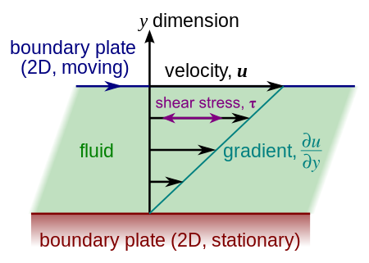
Future research
Shadow graphing
Machine learning
Couette flow
Notes:
Shadowgraphing – info needed; machine learning – patter recognition to identify relationships through various scenarios, feed data to train the model for future simulations, identifies data relationships; state of the environment creating a need for extreme conditions to be accounted for – need for more details analysis.

Slide 22
references
Gharib, Morteza, and Philip Derango. “A Liquid Film (Soap Film) Tunnel to Study Two-Dimensional Laminar and Turbulent Shear Flows.” Physica D: Nonlinear Phenomena, vol. 37, no. 1-3, 1989, pp. 406–416., doi:10.1016/0167-2789(89)90145-0., pp. 406–416., doi:10.1016/0167-2789(89)90145-0.
Jia, Laibing. “Interaction Between Two Parallel Plates in Flow.” The Interaction Between Flexible Plates and Fluid in Two-Dimensional Flow Springer Theses, 2014, pp. 53–71., doi:10.1007/978-3-662-43675-2_4.
Durst, F., A. Melling, and J. Whitelaw. 1981. Principles and Practices of Laser-
Doppler Anemometry. Academic Press
J. W. Hosch and J. P. Walters, "High spatial resolution schlieren photography," Appl. Opt. 16, 473-482 (1977)
R. Marino, P. Mininni, D. Rosenberg, A. Pouquet, Inverse cascades in rotating stratified turbulence: fast growth of large scales, Europhysics Letters, 102, 44006 (2013).
Goto, Susumu, and J.c. Vassilicos. “Streamlines, Coherent Vortices And Pair Diffusion In Two-Dimensional Turbulence.” Fluid Mechanics and Its Applications IUTAM Symposium on Elementary Vortices and Coherent Structures: Significance in Turbulence Dynamics, pp. 131–141., doi:10.1007/1-4020-4181-0_13.

Slide 23
Thank you

