Slide 1
Chapter 6
Internal Control, Cash, and Merchandise Sales
PowerPoint Authors:
Brandy Mackintosh
Lindsay Heiser
Notes:
Chapter 6: Internal Control and Financial Reporting for Cash and Merchandise Sales

Slide 2
Learning Objective 6-1
Distinguish among service, merchandising, and manufacturing
operations.
Notes:
Learning objective 6-1 is to distinguish among service, merchandising, and manufacturing operations.

Slide 3
Operating Cycles
Notes:
A service company sells its services, usually measured in time, bills its customers and receives cash. The company incurs operating expenses relating to the services rendered and starts the process all over again with another client.
A merchandising company, the subject of this chapter, sells products to customers. The customers are billed for the products and the company eventually receives cash for the products sold. A merchandising company incurs operating expenses in connection with promoting and selling its products. The company purchases additional products, usually from a manufacturer, and starts the sales cycle over again.

Slide 4
Operating Cycles
Sell Products
Make Products
Manufacturing Company
Collect Cash
Incur Operating Expenses
Buy Raw Materials
Notes:
A manufacturer also sells products. The customer is billed, and the manufacturer eventually receives cash payment for the sale. The company incurs a variety of expenses in connection with making and selling the product. A manufacturer purchases raw materials and makes its product. Once the product is complete, it is ready for sale.

Slide 5
Learning Objective 6-2
Explain common principles and limitations of internal control.
Notes:
Learning objective 6-2 is to explain common principles and limitations of internal control.

Slide 6
Internal Control
All companies include as part of their operating activities a variety of procedures and policies that are referred to as internal controls.
Internal control is important to all types and sizes of organizations, especially after the business failures and accounting scandals involving Enron and other companies in the early 2000s.
The Sarbanes-Oxley (SOX) Act requires all public companies to assess the effectiveness of internal controls over financial reporting.
Effective internal controls play an essential role in creating an ethical business environment, improving financial performance, and preventing fraud.
Notes:
Part I
All large companies document policies and procedures designed to protect it from fraudulent financial reporting and to promote operational efficiency and effectiveness. Internal controls should alert management to the possible violation of laws and regulations.
Part II
Internal control is important to all types and sizes of organizations, especially after the business failures and accounting scandals involving Enron and other companies in the early 2000s.
Part III
As you may recall from Chapter 5, the Sarbanes-Oxley (SOX) Act requires all public companies to assess the effectiveness of internal controls over financial reporting.
Part IV
Effective internal controls play an essential role in creating an ethical business environment, improving financial performance, and preventing fraud.
A 2010 report by the Association for Certified Fraud Examiners identifies a lack of internal controls as the primary factor in 38 percent of fraud cases.

Slide 7
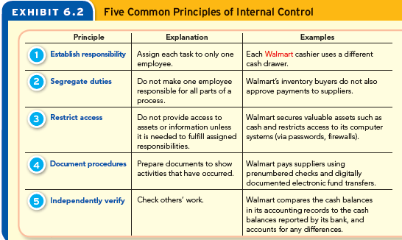
Common Control Principles
Notes:
Here are five basic principles of internal control. Establishing responsibility means assigning each task to only one person. We segregate duties so that one employee cannot make a mistake or commit a dishonest act without someone else knowing about it. It is always a good idea to restrict access to your valuable assets and computer systems. Documents serve as the beginning of the accounting process and are essential to successful business management. A manager reviews, or independently verifies, the work of others to make sure that work is proper.

Slide 8
Control Limitations
Internal controls can never completely prevent and detect errors and fraud.
Benefits vs. Cost
Human Error or Fraud
Notes:
Internal controls can never completely prevent and detect errors and fraud for two reasons. First, an organization will implement internal controls only to the extent that their benefits exceed their costs. Wal-Mart could nearly eliminate shoplifting by body searching every customer who leaves the store, but such an irritating policy would soon drive customers away. For smaller companies, the cost of hiring additional employees to fully segregate duties exceeds the benefits. A second limitation is that internal controls can fail as a result of human error or fraud. People do make simple mistakes in performing control procedures, especially if they are tired, careless, or confused. Criminally minded employees have been known to override (disarm) internal controls or collude (work together) to get around them.

Slide 9
Learning Objective 6-3
Apply internal control principles to cash receipts and payments.
Notes:
Learning objective 6-3 is to apply internal control principles to cash receipts and payments.

Slide 10
Controlling and Reporting Cash
Internal control of cash is important to any organization.
Volume of cash is enormous.
Cash is valuable and “owned” by person possessing it.
Notes:
Internal control of cash is important to any organization for two main reasons. First, because the volume of transactions affecting cash is enormous, any errors that are made in handling cash can quickly add up. Second, because cash is valuable, portable, and “owned” by the person who possesses it, thieves often target it. The Association of Certified Fraud Examiners reports that 85 percent of all known asset thefts involve cash.

Slide 11
Cash Received in Person
Segregate Duties
Cashier
Recording
Custody
Notes:
Businesses can receive cash in two different ways. They can receive it in person at the time of a sale, or they can receive it from a remote source as payment on an account. First, let’s discuss cash received in person.
To properly segregate duties involving cash receipts, specific responsibilities are established and usually assigned to three different employees. First, a cashier is responsible for collecting cash and issuing a receipt at the point of sale. Second, a supervisor is responsible for taking custody of the cash at the end of each cashier’s shift and depositing it in the bank. Third, members of the accounting staff are responsible for ensuring that the receipts from cash sales are properly recorded in the accounting system. If this segregation of duties did not exist, employees could steal the cash and cover up the theft by changing the accounting records. Segregating the duties ensures that those who handle the cash (the cashiers and supervisor) do not have access to those who record it (the accounting staff).

Slide 12
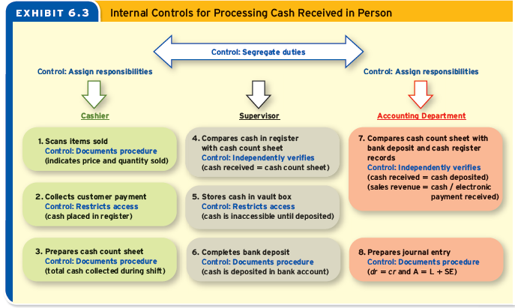
Cash Received in Person
Notes:
Part I
This slide shows, specific responsibilities are assigned to each employee. For example, boxes 1–3 indicate that the cashier uses the cash register and its accompanying point-of-sale accounting system to perform three important functions: (1) document the amount charged for each item sold, (2) restrict access to cash, and (3) summarize the total cash sales. In documenting each item sold (both on screen and on a paper receipt), the cash register reduces errors by allowing customers to dispute any overcharges. By restricting access, the cash register reduces the risk of cash being lost or stolen. By summarizing the total cash sales, the cash register provides an independent record of the amount of cash the cashier should have collected and passed on for deposit at the bank. The cashier uses this information when completing a cash count sheet at the end of each shift. The cash count sheet documents the amount of cash the cashier received and determines any cash short or over that occurred during the shift.
Part II
This slide also shows, in boxes 4–6, that the supervisor performs important controls such as independently verifying each cashier’s count sheet, a copy of which is sent to the accounting department. The supervisor is also responsible for placing the cash in a locked vault until it is taken to the bank for deposit. At that time, a deposit slip listing the amounts included in the deposit is prepared and presented to the bank for a teller to verify. After verifying and receiving the funds, the bank teller stamps the deposit slip, which is then forwarded to the company’s accounting department.
Part III
The accounting department compares the record of cash sales maintained by the cash register with the count sheet prepared by the cashier and the stamped bank deposit slip returned by the bank. This comparison provides independent verification that the amount of cash rung up at the time of sale was deposited into the bank account. Based on this information, a journal entry is prepared to record Sales Revenue at the amount rung up by the cash register and Cash at the amount deposited in the bank. Any difference between the two amounts is recorded in a Cash Shortage (or Overage) account, which is reported on the income statement as a miscellaneous expense (or revenue).

Slide 13
Cash Received from a Remote Source
Cash Received by Mail
Cash Received Electronically
Notes:
Businesses receive checks in the mail when customers pay on account. Because this cash is not received in the form of currency and coins, a cashier is not needed to enter these amounts into a cash register. Instead, the clerk who opens the mail performs this function. In fact, to visualize the following description, you need only glance back at the previous slide and replace the cash register with a mail clerk.
Businesses also receive payments from customers via electronic funds transfer (EFT). An EFT occurs when a customer electronically transfers funds from its bank account to the company’s bank account. Most businesses encourage customers to use EFTs because they speed up collections. A company may not receive mailed payments for five to seven days, but it receives EFTs immediately. And because these payments are deposited directly into the company’s bank account, EFTs eliminate the need for some internal controls. To process an EFT, the accounting department merely records journal entries to debit Cash and credit each customer’s account receivable.

Slide 14
Cash Payments
Cash Payments
Writing a Check
Electronic Funds Transfer
A voucher system is a process for approving and documenting all purchases and payments on account.
Most companies pay cash to their employees through EFTs, which are known by employees as direct deposits.
Notes:
Part I
Companies rarely use dollar bills and coins to pay for purchases. Instead, most cash payments involve (1) writing a check to a supplier, or (2) paying employees via EFT. The primary goal of internal controls for cash payments is to ensure that the business pays only for properly authorized transactions.
Part II
Most businesses purchase goods and services on account and pay for them later by check. Many companies rely on a voucher system to control these transactions. A voucher system is a process for approving and documenting all purchases and payments made on account. The voucher includes the documents prepared at each step in the system.
Part III
Most companies pay cash to their employees through EFTs, which are known by employees as direct deposits. The company initiates the EFT when it instructs its bank to transfer the net pay due each employee directly from the company’s bank account to each employee’s checking account.

Slide 15
Learning Objective 6-4
Perform the key control of reconciling cash to bank statements.
Notes:
Learning objective 6-4 is to perform the key control of reconciling cash to bank statements.

Slide 16
Bank Procedures and Reconciliation
Banks provide services that help businesses to control cash in several ways:
Restricting Access
Documenting Procedures
Independently Verifying
A bank reconciliation is an internal report prepared to verify the accuracy of both the bank statement and the cash accounts of a business or individual.
Notes:
Part I
Banks provide important services to individuals and businesses. They accept deposits, process payments to others, and provide statements that account for these and other transactions. Their services help businesses to control cash in several ways:
Restricting access. Because banks provide a secure place to deposit cash, businesses need to keep only a limited amount of cash on hand, which reduces the risk that it will be stolen or misplaced.
Documenting procedures. By processing payments made by check or EFT, banks facilitate and document business transactions.
Independently verifying. Company accountants can use the statement of account prepared by the bank to double-check the accuracy of the cash records. By comparing these two sets of records and investigating any differences, they can verify that the company’s records are accurate or identify necessary adjustments.
Part II
The process of comparing two sets of records is called reconciling. Thus, the internal accounting report that compares the company’s cash records with the bank’s is a bank reconciliation. A bank reconciliation is a key internal control because it provides independent verification of all cash transactions that the bank has processed for the company. This procedure is done monthly, ideally by a company employee whose duties are segregated from recording and handling cash. You should prepare a bank reconciliation in your own life too, every month. To prepare a bank reconciliation, you must first understand the items on the bank’s statement of account.

Slide 17
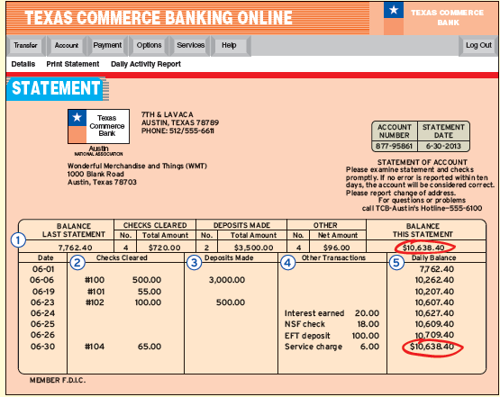
Bank Statement
Notes:
Large businesses such as Wal-Mart can have many bank accounts. For each account a business opens, the bank generates a monthly statement of account that it either mails to the business or makes available online. The format varies from bank to bank, but the statement on this slide is typical. This statement, prepared by Texas Commerce Bank for one of the accounts opened by Wonderful Merchandise and Things (WMT), provides an overall summary of the activity in the account (labeled 1).
The summary is followed by a list of specific transactions posted to the account (labeled 2 through 4).
Checks are listed on the bank statement in the order in which they clear the bank. Look closely at column 2 and you will see that four checks cleared the bank in June. Because WMT’s checks are used in their prenumbered order, the bank statement provides a hint that check 103 did not clear the bank this month. (This fact will be important later when we prepare the bank reconciliation.)
Deposits are listed on the bank statement in the order in which the bank processes them. If you make a deposit after the bank closes (using an ATM or a night deposit chute), it will not appear on the bank statement until the bank processes it the following business day. Knowing this detail will help you to prepare the bank reconciliation.
Column 4 shows that the balance in a bank account can change for a variety of reasons other than checks and deposits.
Finally, column 5 provides a running balance in the account.

Slide 18
Reconciling Differences
Notes:
A bank reconciliation involves comparing the company’s records to the bank’s statement of account to determine whether they agree. The company’s records can differ from the bank’s records for two basic reasons: (1) the company has recorded some items that the bank doesn’t know about at the time it prepares the statement of account or (2) the bank has recorded some items that the company doesn’t know about until the bank statement arrives.

Slide 19
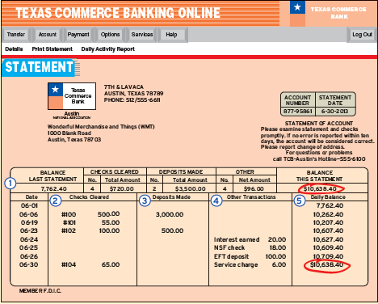
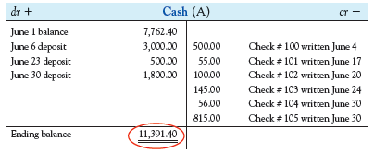
Bank Reconciliation
To determine the appropriate cash balance, these balances need to be reconciled.
Notes:
Notice that WMT’s ending cash balance of $11,391.40 differs from the $10,638.40 ending cash balance shown on the bank statement. To determine the appropriate cash balance, these balances need to be reconciled.

Slide 20
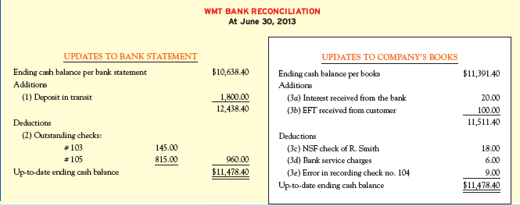
Bank Reconciliation
Bank Reconciliation Goals
Identify the deposits in transit.
Identify the outstanding checks.
Record other transactions on the bank statement.
Determine the impact of errors.
Notes:
Here is the bank reconciliation prepared by WMT for the month of June. The completed reconciliation finds that the up-to-date cash balance is $11,478.40, an amount that differs from both the bank’s statement and WMT’s accounting records. This balance is the amount that WMT will report as Cash on its balance sheet after adjusting its records with the journal entries that we present later. To prepare the bank reconciliation, WMT compared the entries in its Cash account to the bank statement with the following goals:
Identify the deposits in transit.
Identify the outstanding checks.
Record other transactions on the bank statement.
Interest received from the bank.
Electronic funds transfer received from customer.
NSF check rejected.
Service charges.
4. Determine the impact of errors.
Now that we know the up-to-date cash balance is $11,478.40, we need to prepare and record journal entries that will bring the Cash account to that balance. Remember that the entries on the Bank Statement side of the bank reconciliation do not need to be adjusted by WMT because they will work out automatically when the bank processes them next month. Only the items on the Company’s Books side of the bank reconciliation need to be recorded in the company’s records.

Slide 21
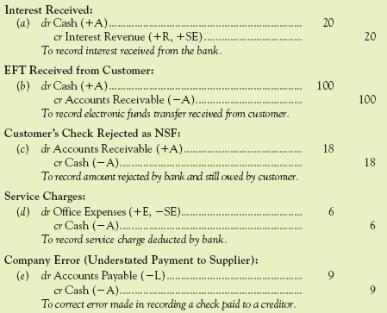
Bank Reconciliation
Notes:
Part I
The $20 interest received from the bank is an addition to the book balance because it’s included in the bank balance but not yet in the company’s books. The entry is to debit Cash and credit Interest Revenue $20.
Part II
The $100 electronic funds transfer received from a customer is an addition to the book balance because it’s included in the bank balance but not yet in the company’s books. The entry is to debit Cash and credit Accounts Receivable $100.
Part III
The $18 NSF check is a deduction from the book balance because it was deducted from the bank statement balance but not yet deducted from the company’s cash records. The entry is a debit to Accounts Receivable and a credit to Cash for $18.
Part IV
The $6 service charges is a deduction from the book balance because it has been deducted from the bank balance but not yet removed from the Cash account in the company’s books. The entry is a debit to Office Expense and a credit to Cash $6.
Part V
Upon checking the journal entries made during the month, WMT found that Check 104 was recorded in the company’s accounts as $56 when, in fact, the check had been written for $65 (in payment of Accounts Payable). To correct its own error, WMT must deduct $9 ($65 minus $56) from the company’s books side of the bank reconciliation. The entry is to debit Accounts Receivable and credit Cash $9.

Slide 22
Reporting Cash and Cash Equivalents
Cash includes money or any instrument that banks will accept for deposit and immediate credit to a company’s account, such as a check, money order, or bank draft.
Cash equivalents are short-term, highly liquid investments purchased within three months of maturity.
Notes:
The account called Cash on the balance sheet includes cash deposited with banks as well as cash on hand (also called petty cash) and cash equivalents. Cash equivalents are short-term, highly liquid investments purchased within three months of maturity. They are considered equivalent to cash because they are both readily convertible to known amounts of cash and so near to maturity that there is little risk their value will change. In your personal life, cash equivalents could include certificates of deposit (CDs) you’ve purchased within three months of maturity.

Slide 23
Learning Objective 6-5
Explain the use of a perpetual inventory system as a control.
Notes:
Learning objective 6-5 is to explain the use of a perpetual inventory system as a control.

Slide 24
Controlling and Reporting Merchandise Sales
Inventory Quantities
Inventory Costs
Financial Statements
Unsold Inventory
Balance Sheet
Sold Inventory
Income Statement
Notes:
Part I
The success of all merchandisers depends on their ability to sell large quantities of merchandise at prices that significantly exceed their cost. Knowing this, merchandisers spend a great deal of time and money tracking their inventory transactions. A strong accounting system plays three roles in this process:
It provides information on inventory quantities so that managers can control inventory levels.
It provides information on inventory costs so that managers can set appropriate selling prices.
It provides information for preparing financial statements, which can be used to evaluate the amount of profit generated from merchandise sales in the current period.
Part II
Until inventory is sold, it is an asset reported at its cost on the balance sheet. After inventory is sold, its cost is removed from the balance sheet and reported on the income statement as an expense, called Cost of Goods Sold. The difference between the selling price (reported as Sales Revenue) and the Cost of Goods Sold is the gross profit earned by the merchandiser.

Slide 25
Perpetual Inventory System
In a perpetual inventory system, the inventory records are updated “perpetually,” that is, every time inventory is bought, sold, or returned. Perpetual systems often are combined with bar codes and optical scanners.
Notes:
A perpetual inventory system updates inventory records every time an item is bought, sold or returned. You may not realize it, but the bar-code readers at Wal-Mart’s checkouts serve two purposes: (1) they calculate and record the sales revenue for each product you’re buying, and (2) they remove the product and its cost from Wal-Mart’s inventory records. Similar scanners are used back in the “employees only” part of the store, where products are unloaded from the trucks or returned to suppliers. As a result of this continuous, or “perpetual,” updating, the balances in Wal-Mart’s Inventory and Cost of Goods Sold accounts are always up to date.

Slide 26
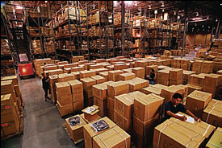
Periodic Inventory System
In a periodic inventory system,
the inventory records are updated “periodically,” that is, at the end of the accounting period. To determine how much merchandise has been sold, periodic systems require that inventory be physically counted at the end of the period.
Notes:
Unlike a perpetual system, which updates the inventory records immediately after each purchase, sale, and return of merchandise, a periodic inventory system updates the inventory records only at the end of the accounting period. Although simple to maintain, a major drawback of a periodic system is that accurate records of the inventory on hand and the inventory that has been sold are unavailable. To determine these amounts, employees must physically count the inventory, which they do at the end of the period, when the store is “closed for inventory.” This inventory count is then used to adjust the balances for Inventory and Cost of Goods Sold.

Slide 27
Inventory Control
Perpetual Inventory System
Periodic Inventory System
Continuous Tracking
No Up-to-Date Records
Can Estimate Shrinkage
Can’t Estimate Shrinkage
Notes:
A perpetual inventory system’s continuous tracking of transactions allows companies to keep just the right quantity of products on the shelves for just the right amount of time. Doing so saves companies a great deal of money in financing and storage charges. It also benefits consumers, who pay less for the products they buy.
Another benefit of a perpetual inventory system is that it allows managers to estimate shrinkage, the politically correct term for loss of inventory from theft, fraud, and error.
Because a perpetual inventory system records all goods purchased and sold, the ending inventory in the company’s perpetual records indicates how many units should be on hand.
Notice that you can’t do this kind of detective work with a periodic inventory system because it doesn’t provide an up-to-date record of the inventory that should be on hand when you count it. Also note that, even if you’re using a perpetual inventory system, you still need to count the inventory occasionally (at least yearly) to ensure the accounting records are accurate and that any shrinkage is detected.

Slide 28
Learning Objective 6-6
Analyze sales transactions under a perpetual inventory system.
Notes:
Learning objective 6-6 is to analyze sales transactions under a perpetual inventory system.

Slide 29
Sales Transactions
Merchandisers earn revenues by transferring ownership of merchandise to a customer, either for cash or on credit.
For a merchandiser who is shipping goods to a customer, the transfer of ownership occurs at one of two possible times:
FOB shipping point —the sale is recorded when the goods leave the seller’s shipping department.
FOB destination —the sale is recorded when the goods reach their destination (the customer).
Notes:
Part I
As required by the revenue principle, merchandisers record revenue when it is earned. Merchandisers earn revenues by making a “sale,” which means transferring ownership of merchandise to a customer, either for cash or on credit.
Part II
For a retail merchandiser like Wal-Mart, this transfer of ownership occurs when a customer buys and takes possession of the goods at checkout. For a wholesale merchandiser who is shipping goods to a customer, the transfer of ownership occurs at a time stated in the written sales agreement. The sales agreement will specify one of two possible times:
FOB shipping point —the sale is recorded when the goods leave the seller’s shipping department.
FOB destination —the sale is recorded when the goods reach their destination (the customer).
Unless otherwise indicated, the examples in this book assume that ownership transfers when goods are shipped (FOB shipping point), which usually means the buyer pays for all transportation costs.

Slide 30
Sales Transactions
Every merchandise sale has two components, each of which requires an entry in a perpetual inventory system.
Selling Price
Cost
Notes:
Part I
Every merchandise sale has two components, and in a perpetual inventory system, each of these two components require an entry.
Part II
Selling price. Wal-Mart’s sales price is recorded as an increase in Sales Revenue and a corresponding increase in either Cash (for a cash sale) or Accounts Receivable (for a credit sale).
Part III
Cost. The cost that Wal-Mart incurred to initially buy the merchandise is removed from Inventory and reported as an expense called Cost of Goods Sold (CGS).

Slide 31
Sales Transactions
Assume Wal-Mart sells two Schwinn mountain bikes for $400 cash. The bikes had previously been recorded in Wal-Mart’s Inventory at a total cost of $350.
1
Analyze
Liabilities
Assets
=
+
Stockholders’ Equity
Cash +$400
Inventory -$350
Sales Revenue (+R) +$400
Cost of Goods Sold (+E) -$350
2
Record
dr Cash (+A)
cr Sales Revenue (+R, +SE)
dr Cost of Goods Sold (+E, -SE)
cr Inventory (-A)
400
350
400
350
Notes:
Part I
Assume Wal-Mart sells two Schwinn mountain bikes for $400 cash. The bikes had previously been recorded in Wal-Mart’s Inventory at a total cost of $350.
Part II
In this transaction, Cash, an asset, increased by $400, and Sales Revenue, a subcategory of Stockholders’ Equity, increased by the same amount. Also, Inventory, an asset, decreased by $350 and Cost of Goods Sold, a subcategory of Stockholders’ Equity, increased by $350, which ultimately reduces Stockholders’ Equity.
Part III
The general journal entries are a debit to Cash and a credit to Sales Revenue for $400, and a debit to Cost of Goods Sold and a credit to Inventory for $350.

Slide 32
Sales Returns and Allowances
When goods sold to a customer arrive in damaged condition or are otherwise unsatisfactory, the customer can (1) return them for a full refund or (2) keep them and ask for a reduction in the selling price, called an allowance.
Notes:
When goods sold to a customer arrive in damaged condition or are otherwise unsatisfactory, the customer can (1) return them for a full refund or (2) keep them and ask for a reduction in the selling price, called an allowance. These sales returns and allowances require Wal-Mart to revise the previously recorded sale and, in the case of returns, to revise the previously recorded inventory reduction and cost of goods sold.

Slide 33
Sales Returns and Allowances
Suppose that after Wal-Mart sold the two Schwinn mountain bikes, the customer returned one to Wal-Mart. Assuming that the bike is still like new, Wal-Mart would refund the $200 selling price to the customer and take the bike back into inventory.
1
Analyze
Liabilities
Assets
=
+
Stockholders’ Equity
Cash -$200
Inventory +$175
Sales Returns and
Allowances (+xR) -$200
Cost of Goods Sold (-E) +$175
2
Record
dr Sales Returns & Allowances (+xR, -SE)
cr Cash (-A)
dr Inventory (+A)
cr Cost of Goods Sold (-E, +SE)
200
175
200
175
Notes:
Part I
Suppose that after Wal-Mart sold the two Schwinn mountain bikes, the customer returned one to Wal-Mart. Assuming that the bike is still like new, Wal-Mart would refund the $200 selling price to the customer and take the bike back into inventory.
Part II
In this transaction, Cash, an asset, decreased by $200, and Sales Returns and Allowances, a contra-revenue account, increased by the same amount which ultimately reduces stockholders’ equity. Also, Inventory, an asset, increased by $175 and Cost of Goods Sold, a subcategory of Stockholders’ Equity, decreased by $175, which ultimately increases Stockholders’ Equity.
Part III
The general journal entries are a debit to Sales Returns and Allowances and credit to Cash for $200, and a debit to Inventory and a credit to Cost of Goods Sold for $175.
Using a contra-revenue account instead of directly reducing the Sales account allows Walmart to track the value of goods returned, providing clues about whether customers are happy with the quality and price of Walmart ’s products.

Slide 34
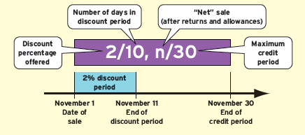
Sales on Account and Sales Discounts
A sales discount is a sales price reduction given to customers for prompt payment of their account balance.
Notes:
When a merchandiser makes a sale on account, it gives up its inventory but receives only a promise of being paid cash later. To encourage customers to make these payments promptly, a merchandiser often specifies payment terms such as “2/10, n/30.” The “2/10” means that if the customer pays within 10 days of the sale date, a 2 percent sales discount will be deducted from the selling price. The “n/30” part means that if payment is not made within the 10-day discount period, the full amount will be due 30 days after the date of sale.

Slide 35
Sales on Account and Sales Discounts
Suppose Wal-Mart’s warehouse store (Sam’s Club) sells printer paper on account to a local business for $1,000 with payment terms of 2/10, n/30. The paper cost Sam’s Club $700.
1
Analyze
Liabilities
Assets
=
+
Stockholders’ Equity
Accounts Receivable+$1,000
Inventory -$700
Sales Revenue (+R) +$1,000
Cost of Goods Sold (+E) -$700
2
Record
dr Accounts Receivable (+A)
cr Sales Revenue (+R, +SE)
dr Cost of Goods Sold (+E, -SE)
cr Inventory (-A)
1,000
700
1,000
700
Notes:
Part I
Suppose Wal-Mart’s warehouse store (Sam’s Club) sells printer paper on account to a local business for $1,000 with payment terms of 2/10, n/30. The paper cost Sam’s Club $700.
Part II
In this transaction, Accounts Receivable, an asset, increased by $1,000, and Sales Revenue, a subcategory of Stockholders’ Equity, increased by the same amount. Also, Inventory, an asset, decreased by $700 and Cost of Goods Sold, a subcategory of Stockholders’ Equity, increased by $700, which ultimately reduces Stockholders’ Equity.
Part III
The general journal entries are a debit to Accounts Receivable and credit to Sales Revenue for $1,000, and a debit to Cost of Goods Sold and a credit to Inventory for $700.

Slide 36
Sales on Account and Sales Discounts
To take advantage of this 2% discount, the customer must pay Wal-Mart within 10 days. If the customer does so, it will deduct the $20 discount (2% $1,000) from the total owed ($1,000), and then pay $980 to Wal-Mart.
1
Analyze
Liabilities
Assets
=
+
Stockholders’ Equity
Cash +$980
Accounts Receivable -$1,000
Sales Discounts (+xR) -$20
2
Record
dr Cash (+A)
dr Sales Discounts (+xR, -SE)
cr Accounts Receivable (-A)
980
20
1,000
(2% × $1,000)
Notes:
Part I
To take advantage of this 2% discount, the customer must pay Wal-Mart within 10 days. If the customer does so, it will deduct the $20 discount (2% times $1,000) from the total owed ($1,000), and then pay $980 to Wal-Mart.
Part II
In this transaction, Cash, an asset, increased by $980, Accounts Receivable, an asset, decreased by $1,000, and Sales Discounts, a contra-revenue account, increased by $20, which ultimately reduces Stockholders’ Equity.
Part III
The general journal entry is a debit to Cash for $980, a debit to Sales Discounts for $20, and a credit to Accounts Receivable for $1,000.
If the customer doesn’t pay by the end of the discount period, Wal-Mart would not allow the customer to take a discount for early payment. Instead, the customer would have to pay the full $1,000, which Wal-Mart would record as an increase in Cash (debit) and a decrease in Accounts Receivable (credit).

Slide 37
Summary of Sales-Related Transactions
The sales returns and allowances and sales discounts introduced in this section were recorded using contra-revenue accounts.
Notes:
The sales returns and allowances and sales discounts introduced in this section were recorded using contra-revenue accounts. This slide summarizes their effects on sales reporting. The documentation procedure involving contra-revenue accounts allows managers to monitor and control how sales discounts, returns, and allowances affect the company’s revenues. For example, frequent returns of defective products would show up as an increase in the Sales Returns and Allowances account. In response to such an increase, Wal-Mart’s managers might decide to discontinue the product or find a new supplier.
Detailed information relating to sales discounts and returns is a key part of a merchandiser’s business operations. To avoid revealing these secrets to competitors, most companies report these contra-accounts only on their internal financial statements. Externally reported income statements almost never include contra-revenue accounts. Instead, externally reported income statements begin with Net Sales.

Slide 38
Learning Objective 6-7
Analyze a merchandiser’s multistep income statement.
Notes:
Learning objective 6-7 is to analyze a merchandiser’s multistep income statement.

Slide 39
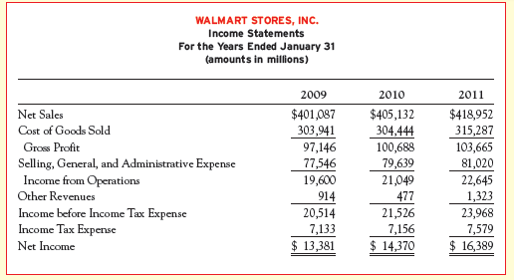
Gross Profit Percentage
Gross Profit %
Gross Profit Net Sales
=
×
100
Notes:
Part I
Gross profit (also called gross margin or simply margin) is Net Sales minus Cost of Goods Sold. It is a subtotal, not an account.
Part II The gross profit percentage is gross profit (which is Net Sales minus Cost of Goods Sold) divided by Net Sales, which is then multiplied by 100. The gross profit percentage measures the percentage of gross profit earned on each dollar of sales. This ratio is used (1) to analyze changes in the company’s operations over time, (2) to compare one company to another, and (3) to determine whether a company is earning enough on each sale to cover its operating expenses. A higher gross profit percentage means that the company is selling products for a greater markup over its cost.

Slide 40
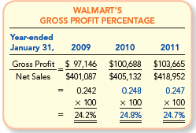
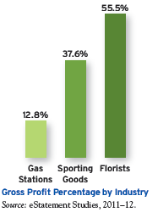
Comparing Operating Results Across Companies and Industries
Notes:
Part I
Be aware that gross profit percentages can vary greatly between companies. Wal-Mart’s gross profit percentage of 24.7 percent is characteristic of its slogan of “Saving people money so they can live better.” Wal-Mart’s strategy is to earn a relatively small amount of profit on each dollar of sales, but to compensate by generating a huge volume of sales.
Part II
In contrast, high-end department stores carry fashions with high-end prices, resulting in fewer sales, but more profit on each sale. In 2011, Sak’s reported a 40.1 percent gross profit percentage. Gross profit percentages can vary across industries too. As seen in this slide, gas stations compared to florists have a much lower gross profit percentage. Another example is oil and gas exploration companies which recently reported an average gross profit percentage of 63.5 percent, which they need to cover their research and exploration expenses.

Slide 41
Chapter 6 Solved Exercises
M6-10, M6-19, E6-5, E6-7, E6-10, E6-17
Notes:
Chapter 6 Solved Exercises: M6-10, M6-19, E6-5, E6-7, E6-10, E6-17

Slide 42
M6-10 Calculating Shrinkage in a Perpetual Inventory System
Corey’s Campus Store has $4,000 of inventory on hand at the beginning of the month. During the month, the company buys $41,000 of merchandise and sells merchandise that had cost $30,000. At the end of the month, $13,000 of inventory is on hand. How much shrinkage occurred during the month?
Beginning inventory
Purchases
Cost of Goods Sold
Ending balance
Inventory count
Shrinkage
$ 4,000
+41,000
-30,000
15,000
-13,000
$ 2,000
Notes:
Part I
M6-10 Calculating Shrinkage in a Perpetual Inventory System
Corey’s Campus Store has $4,000 of inventory on hand at the beginning of the month. During the month, the company buys $41,000 of merchandise and sells merchandise that had cost $30,000. At the end of the month, $13,000 of inventory is on hand. How much shrinkage occurred during the month?
Part II
The shrinkage for the month is $2,000 and is calculated as shown on this slide.

Slide 43
M6-19 Calculating the Impact of Changes in Gross Profit Percentage on Operating Income
Luxottica Group, the Italian company that sells Ray Ban and Killer Loop sunglasses, reported a gross profit percentage of 66.4 percent in 2008 and 65.4 percent in 2009. In each of these two years, the company’s net sales was fairly steady at approximately 5 million euro. Assuming that Luxottica’s operating expenses were 2.6 million euro in each year, how much more (or less) income from operations did Luxottica report in 2009 than in 2008?
Sales
Gross profit percentage
Gross Profit
Operating Expenses
Income from Operations
Luxottica earned € 50,000 less in 2009 than 2008.
2008
€5,000,000
x 0.664
3,320,000
2,600,000
€ 720,000
2009
€5,000,000
x 0.654
3,270,000
2,600,000
€ 670,000
Notes:
Part I
M6-19 Calculating the Impact of Changes in Gross Profit Percentage on Operating Income
Luxottica Group, the Italian company that sells Ray Ban and Killer Loop sunglasses, reported a gross profit percentage of 66.4 percent in 2008 and 65.4 percent in 2009. In each of these two years, the company’s net sales was fairly steady at approximately 5 million euro. Assuming that Luxottica’s operating expenses were 2.6 million euro in each year, how much more (or less) income from operations did Luxottica report in 2009 than in 2008?
Part II
First, we need to determine Luxxotica’s gross profit for each year. In 2008 the gross profit was 3,320,000 euro, and in 2009 the gross profit was 3,270,000 euro. From the gross profit, subtract the 2,600,000 euro in operating expenses to arrive at income from operations. From this analysis, we can see that Luxxotica earned 50,000 euro less in income from operations 2009 than in 2008.

Slide 44
E6-5 Preparing a Bank Reconciliation and Journal Entries, and Reporting Cash
Hills Company’s June 30, 2013, bank statement and the June ledger account for cash are summarized here:
Required:
1. Prepare a bank reconciliation. A comparison of the checks written with the checks that have cleared the bank shows outstanding checks of $700. Some of the checks that cleared in June were written prior to June. No deposits in transit were noted in May, but a deposit is in transit at the end of June.
Notes:
E6-5 Preparing a Bank Reconciliation and Journal Entries, and Reporting Cash
Hills Company’s June 30, 2013, bank statement and the June ledger account for cash are summarized on this slide.
Required:
1. Prepare a bank reconciliation. A comparison of the checks written with the checks that have cleared the bank shows outstanding checks of $700. Some of the checks that cleared in June were written prior to June. No deposits in transit were noted in May, but a deposit is in transit at the end of June.

Slide 45
E6-5 Preparing a Bank Reconciliation and Journal Entries, and Reporting Cash
HILLS COMPANY
Bank Reconciliation
June 30, 2013
Bank Statement
Ending balance per bank
statement………………..
Additions:
Deposit in transit…………….
Deductions:
Outstanding checks………...
Up-to-date cash balance…...
*$19,000 - $18,000 = $1,000.
$ 6,070
*1,000
7,070
700
$6,370
Company’s Books
Ending balance per Cash
account ………………..
Additions:
None
Deductions:
Bank service charge...……...
Up-to-date cash balance…...
$ 6,400
6,400
30
$6,370
Notes:
Part I
On the bank statement side of the bank reconciliation, we start with $6,070 as the ending balance per the bank statement and make adjustments for the $1,000 deposit in transit and $700 in outstanding checks. The up-to-date cash balance is $6,370.
Part II
On the company’s side of the bank reconciliation, we start with $6,400 as the ending balance per the company’s cash account and subtract the $30 bank service charge. The up-to-date cash balance is $6,370.

Slide 46
E6-5 Preparing a Bank Reconciliation and Journal Entries, and Reporting Cash
Give any journal entries that should be made as a result of the bank reconciliation.
What is the balance in the Cash account after the reconciliation entries?
In addition to the balance in its bank account, Hills Company also has $300 cash on hand. This amount is recorded in a separate T-account called Cash on Hand. What is the total amount of cash that should be reported on the balance sheet at June 30?
dr Office Expenses (+E, -SE)
cr Cash (-A)
To record bank service charges.
30
30
$6,370 ($6,400 - $30)
Balance sheet (June 30, 2013):
Current assets:
Cash ($6,370 + $300)
$6,670
Notes:
Part I
2. Give any journal entries that should be made as a result of the bank reconciliation.
Part II
The entry needed is debit Office Expense and credit Cash for $30.
What is the balance in the Cash account after the reconciliation entries?
Part III
The up-to-date Cash balance is $6,370.
In addition to the balance in its bank account, Hills Company also has $300 cash on hand. This amount is recorded in a separate T-account called Cash on Hand. What is the total amount of cash that should be reported on the balance sheet at June 30?
Part IV
The Cash balance on the balance sheet would be $6,670 ($6,370 + $300).

Slide 47
E6-7 Identifying Shrinkage and Other Missing Inventory Information
Calculate the missing information for each of the following independent cases:
Case
Beg. Inventory
Purchases
Cost of Goods Sold
Ending Inventory (perpetual)
Ending Inventory
(As Counted)
Shrinkage
A
B
C
D
$100
200
150
260
$700
800
500
600
$300
850
200
650
$500
150
450
210
$420
150
440
200
$80
0
10
10
?
?
?
?
?
?
?
Notes:
Part I
E6-7 Identifying Shrinkage and Other Missing Inventory Information
Calculate the missing information for each of the following independent cases:
A: Beginning Inventory, $100; Purchases, $700; Cost of Goods Sold, $300, and Ending Inventory as counted, $420.
Part II
The Ending Inventory per the perpetual records is $500, which leaves a shrinkage of $80.
B: Beginning Inventory, $200; Purchases, $800; Ending Inventory per the perpetual records, $150; and Ending Inventory as counted, $150.
Part III
The Cost of Goods Sold is $850 and the shrinkage is $0.
C: Beginning Inventory, $150; Purchases, $500; Cost of Goods Sold, $200; Ending Inventory per the perpetual records, $450; and Shrinkage, $10.
Part IV
The Ending Inventory as counted is $440.
D: Beginning Inventory, $260; Cost of Goods Sold, $650; Ending Inventory per the perpetual records, $210; and Ending Inventory as counted, $200.
Part V
Inventory purchased is $600 and shrinkage is $10.

Slide 48
E6-10 Recording Journal Entries for Net Sales with Credit Sales and Sales Discounts
Using the information in E6-9, prepare journal entries to record the transactions, assuming Solitare uses a perpetual inventory system.
Jan. 6 Sold goods for $100 to Wizard Inc. with terms 2/10, n/30. The
goods cost Solitare $70.
6 Sold goods to SpyderCorp for $80 with terms 2/10, n/30. The
goods cost Solitare $60.
14 Collected cash due from Wizard Inc.
Feb. 2 Collected cash due from SpyderCorp.
28 Sold goods for $50 to Bridges with terms 2/10, n/45. The
goods cost Solitare $30.
Jan. 6
dr Accounts Receivable (+A)
cr Sales Revenue (+R, +SE)
dr Cost of Goods Sold (+E, -SE)
cr Inventory (-A)
100
70
100
70
Notes:
Part I
E6-10 Recording Journal Entries for Net Sales with Credit Sales and Sales Discounts
Using the information in E6-9, prepare journal entries to record the transactions, assuming Solitare uses a perpetual inventory system.
Jan. 6: Sold goods for $100 to Wizard Inc. with terms 2/10, n/30. The goods cost Solitare $70.
Part II
The first entry is to debit Accounts Receivable and credit Sales Revenue for $100. The second entry is to debit Cost of Goods Sold and credit Inventory for $70.

Slide 49
E6-10 Recording Journal Entries for Net Sales with Credit Sales and Sales Discounts
Using the information in E6-9, prepare journal entries to record the transactions, assuming Solitare uses a perpetual inventory system.
Jan. 6 Sold goods for $100 to Wizard Inc. with terms 2/10, n/30. The
goods cost Solitare $70.
6 Sold goods to SpyderCorp for $80 with terms 2/10, n/30. The
goods cost Solitare $60.
14 Collected cash due from Wizard Inc.
Feb. 2 Collected cash due from SpyderCorp.
28 Sold goods for $50 to Bridges with terms 2/10, n/45. The
goods cost Solitare $30.
Jan. 6
dr Accounts Receivable (+A)
cr Sales Revenue (+R, +SE)
dr Cost of Goods Sold (+E, -SE)
cr Inventory (-A)
80
60
80
60
Notes:
Part I
Jan. 6: Sold goods for $100 to SpyderCorp for $80 with terms 2/10, n/30. The goods cost Solitare $60.
Part II
The first entry is to debit Accounts Receivable and credit Sales Revenue for $80. The second entry is to debit Cost of Goods Sold and credit Inventory for $60.

Slide 50
E6-10 Recording Journal Entries for Net Sales with Credit Sales and Sales Discounts
Using the information in E6-9, prepare journal entries to record the transactions, assuming Solitare uses a perpetual inventory system.
Jan. 6 Sold goods for $100 to Wizard Inc. with terms 2/10, n/30. The
goods cost Solitare $70.
6 Sold goods to SpyderCorp for $80 with terms 2/10, n/30. The
goods cost Solitare $60.
14 Collected cash due from Wizard Inc.
Feb. 2 Collected cash due from SpyderCorp.
28 Sold goods for $50 to Bridges with terms 2/10, n/45. The
goods cost Solitare $30.
Jan. 14
dr Cash (+A) ($100 x 98%)
dr Sales Discounts (+xR, -SE) ($100 x 2%)
cr Accounts Receivable (-A)
98
2
100
Notes:
Part I
Jan. 14: Collected cash due from Wizard Inc.
Part II
Because Wizard Inc. paid within the discount period, the entry is to debit Cash $98, debit Sales Discounts $2, and credit Accounts Receivable $100.

Slide 51
E6-10 Recording Journal Entries for Net Sales with Credit Sales and Sales Discounts
Using the information in E6-9, prepare journal entries to record the transactions, assuming Solitare uses a perpetual inventory system.
Jan. 6 Sold goods for $100 to Wizard Inc. with terms 2/10, n/30. The
goods cost Solitare $70.
6 Sold goods to SpyderCorp for $80 with terms 2/10, n/30. The
goods cost Solitare $60.
14 Collected cash due from Wizard Inc.
Feb. 2 Collected cash due from SpyderCorp.
28 Sold goods for $50 to Bridges with terms 2/10, n/45. The
goods cost Solitare $30.
Feb. 2
dr Cash (+A)
cr Accounts Receivable (-A)
80
80
Notes:
Part I
Feb. 2: Collected cash due from SpyderCorp.
Part II
Because SpyderCorp paid outside of the discount period, the entry is to debit Cash and credit Accounts Receivable $80.

Slide 52
E6-10 Recording Journal Entries for Net Sales with Credit Sales and Sales Discounts
Using the information in E6-9, prepare journal entries to record the transactions, assuming Solitare uses a perpetual inventory system.
Jan. 6 Sold goods for $100 to Wizard Inc. with terms 2/10, n/30. The
goods cost Solitare $70.
6 Sold goods to SpyderCorp for $80 with terms 2/10, n/30. The
goods cost Solitare $60.
14 Collected cash due from Wizard Inc.
Feb. 2 Collected cash due from SpyderCorp.
28 Sold goods for $50 to Bridges with terms 2/10, n/45. The
goods cost Solitare $30.
Feb. 28
dr Accounts Receivable (+A)
cr Sales Revenue (+R, +SE)
dr Cost of Goods Sold (+E, -SE)
cr Inventory (-A)
50
30
50
30
Notes:
Part I
Feb. 28: Sold goods for $50 to Bridges with terms 2/10, n/45. The goods cost Solitare $30.
Part II
The first entry is to debit Accounts Receivable and credit Sales Revenue for $50. The second entry is to debit Cost of Goods Sold and credit Inventory for $30.

Slide 53
E6-17 Inferring Missing Amounts Based on Income Statement Relationships
Supply the missing dollar amounts for the income statement of Williamson Company for each of the following independent cases:
Sales Revenue
Sales Returns and Allowances
Net Sales
Cost of Goods Sold
Gross Profit
Case A
$ 8,000
150
7,850
5,750
$ 2,100
Case B
$ 6,000
500
5,500
4,050
$ 1,450
Case C
$ 6,195
275
5,920
5,400
$ 520
Notes:
Part I
E6-17 Inferring Missing Amounts Based on Income Statement Relationships
Supply the missing dollar amounts for the income statement of Williamson Company for each of the following independent cases. We will start with Case A.
Part II
For Case A, Net Sales is $7,850 and Gross Profit is $2,100.
Part III
For Case B, Sales Returns and Allowances is $500 and Net Sales is $5,500.
Part IV
For Case C, Sales Revenue is $6,195 and Gross Profit is $520.

Slide 54
End of Chapter 6
Notes:
End of chapter 6.

